Slide 1
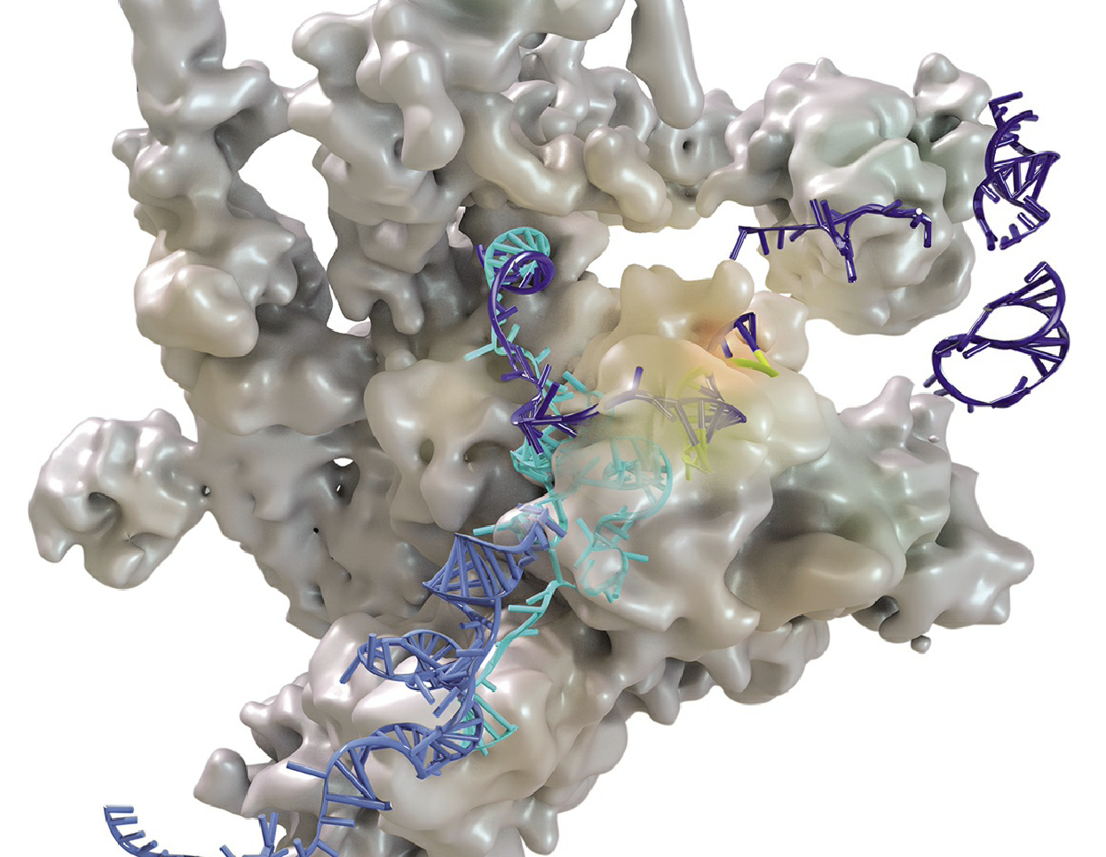
Biochemistry Comprehensive Homework
Biology Preparatory Course Class 9
2020-2021 Fall

Slide 2
Group Members
崔逸丰: Amino Acid Metabolism
戴玥: Carbohydrate Degradation Metabolism
吴亦乐: Lipid Metabolism
钟子涵: Carbohydrate Synthesis Metabolism

Slide 3
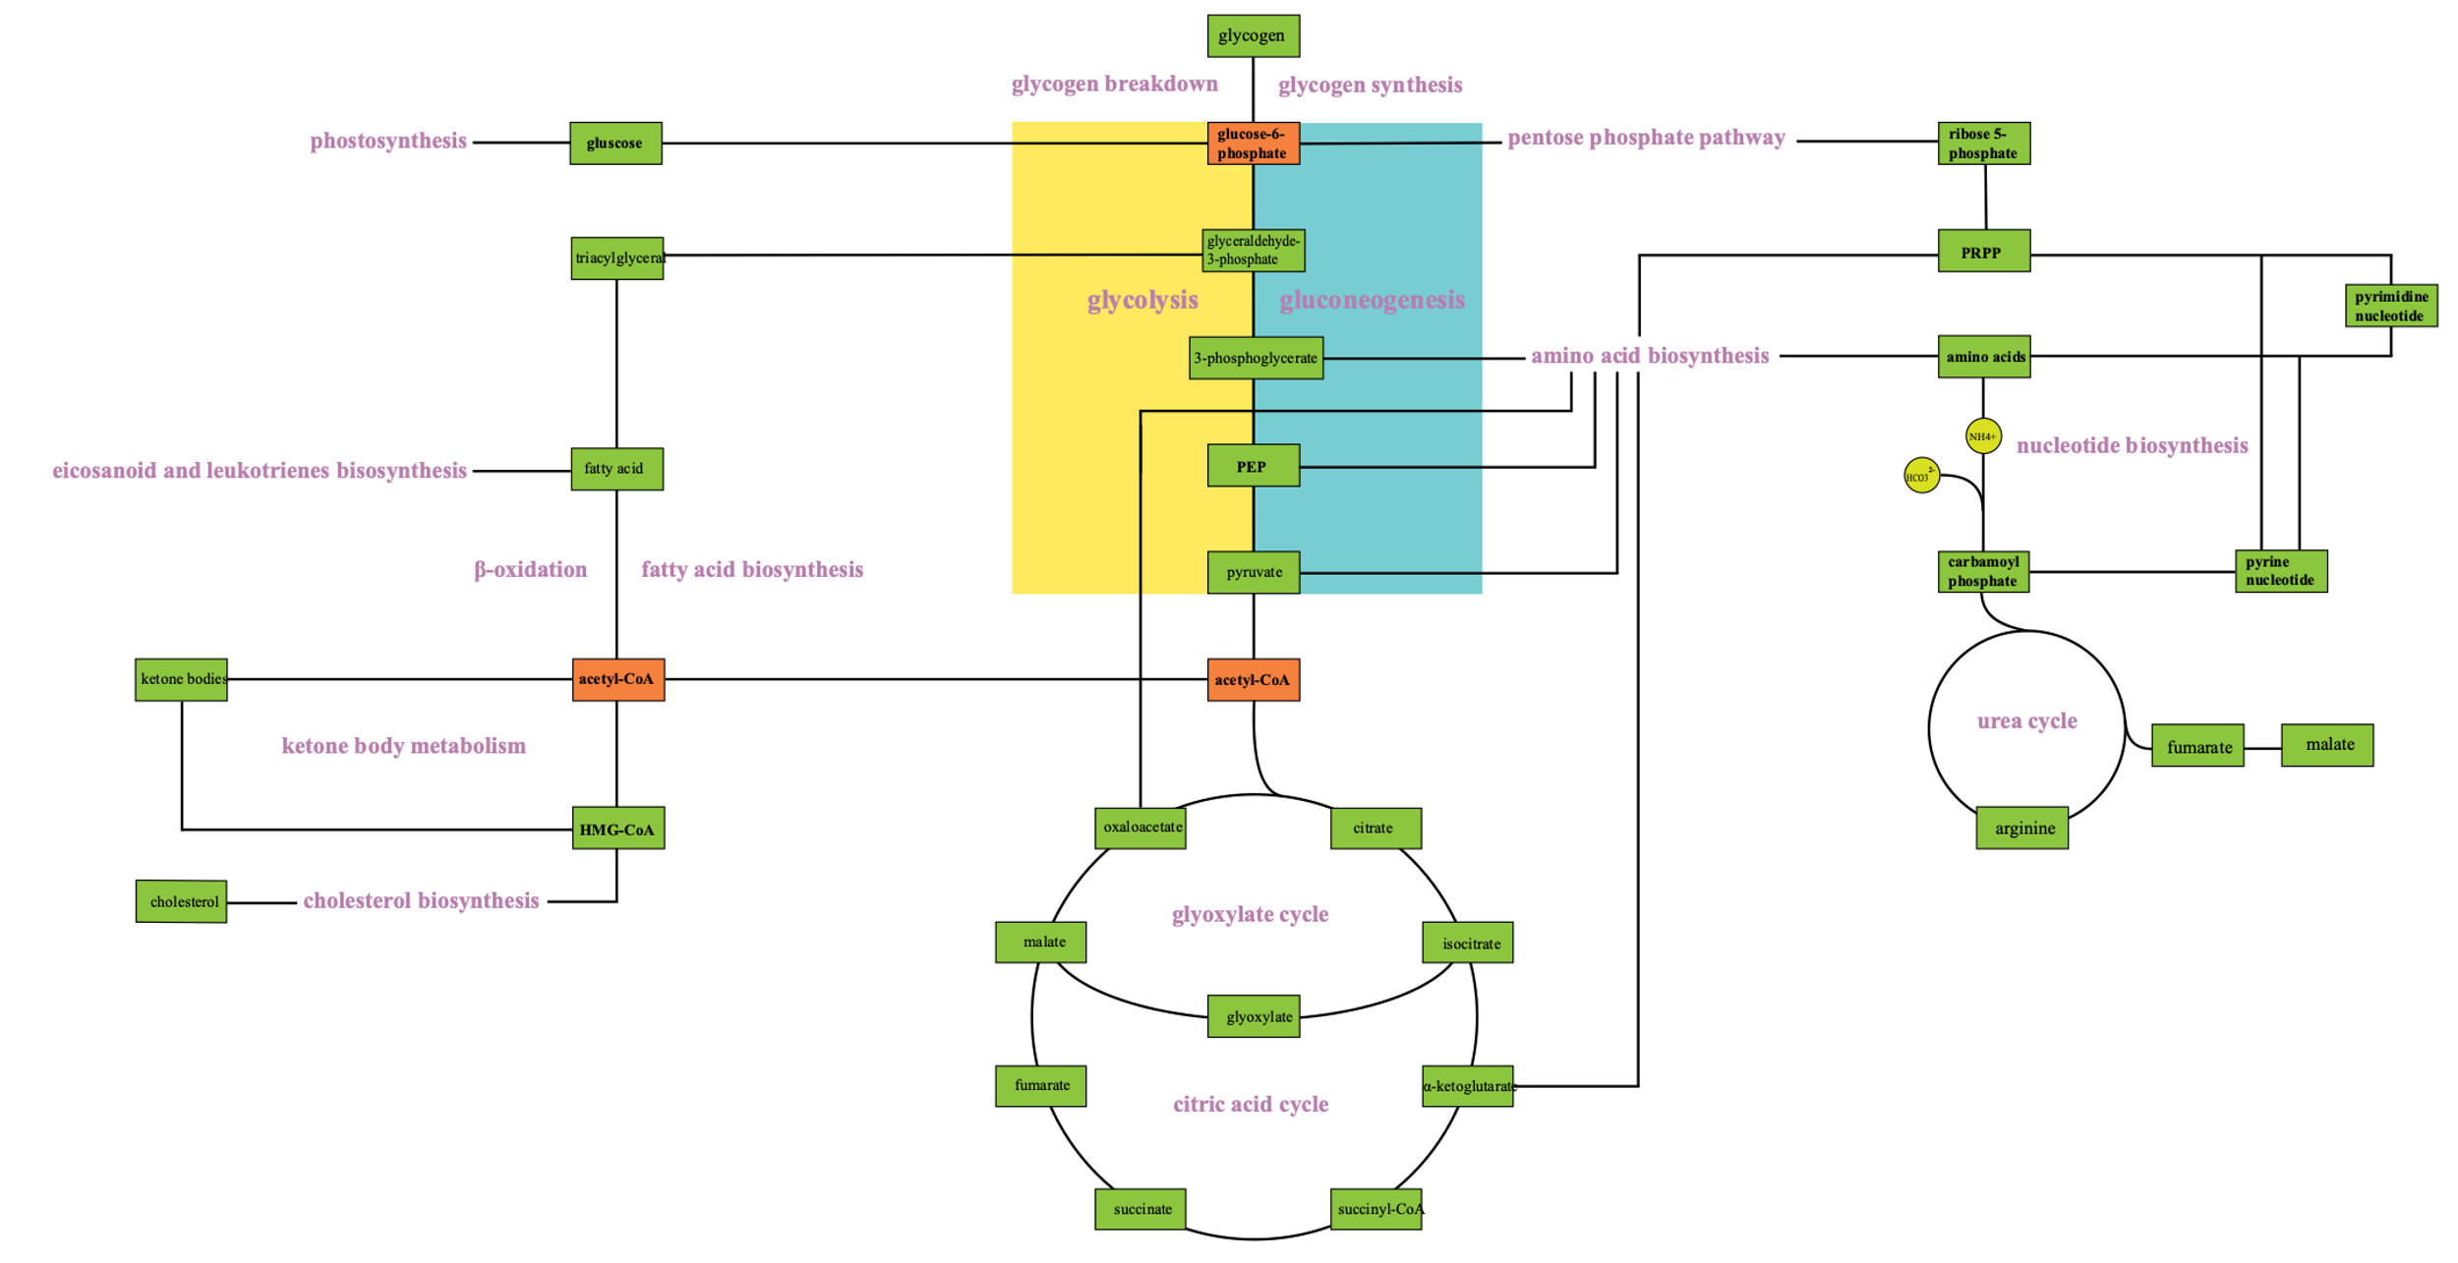
Carbohydrate Synthesis
Lipid
Metabolism
Carbohydrate Degradation
Nucleotide and Amino Acid Metabolism
Big Map of Metabolism Biochemistry
by Wu Yile

Slide 4
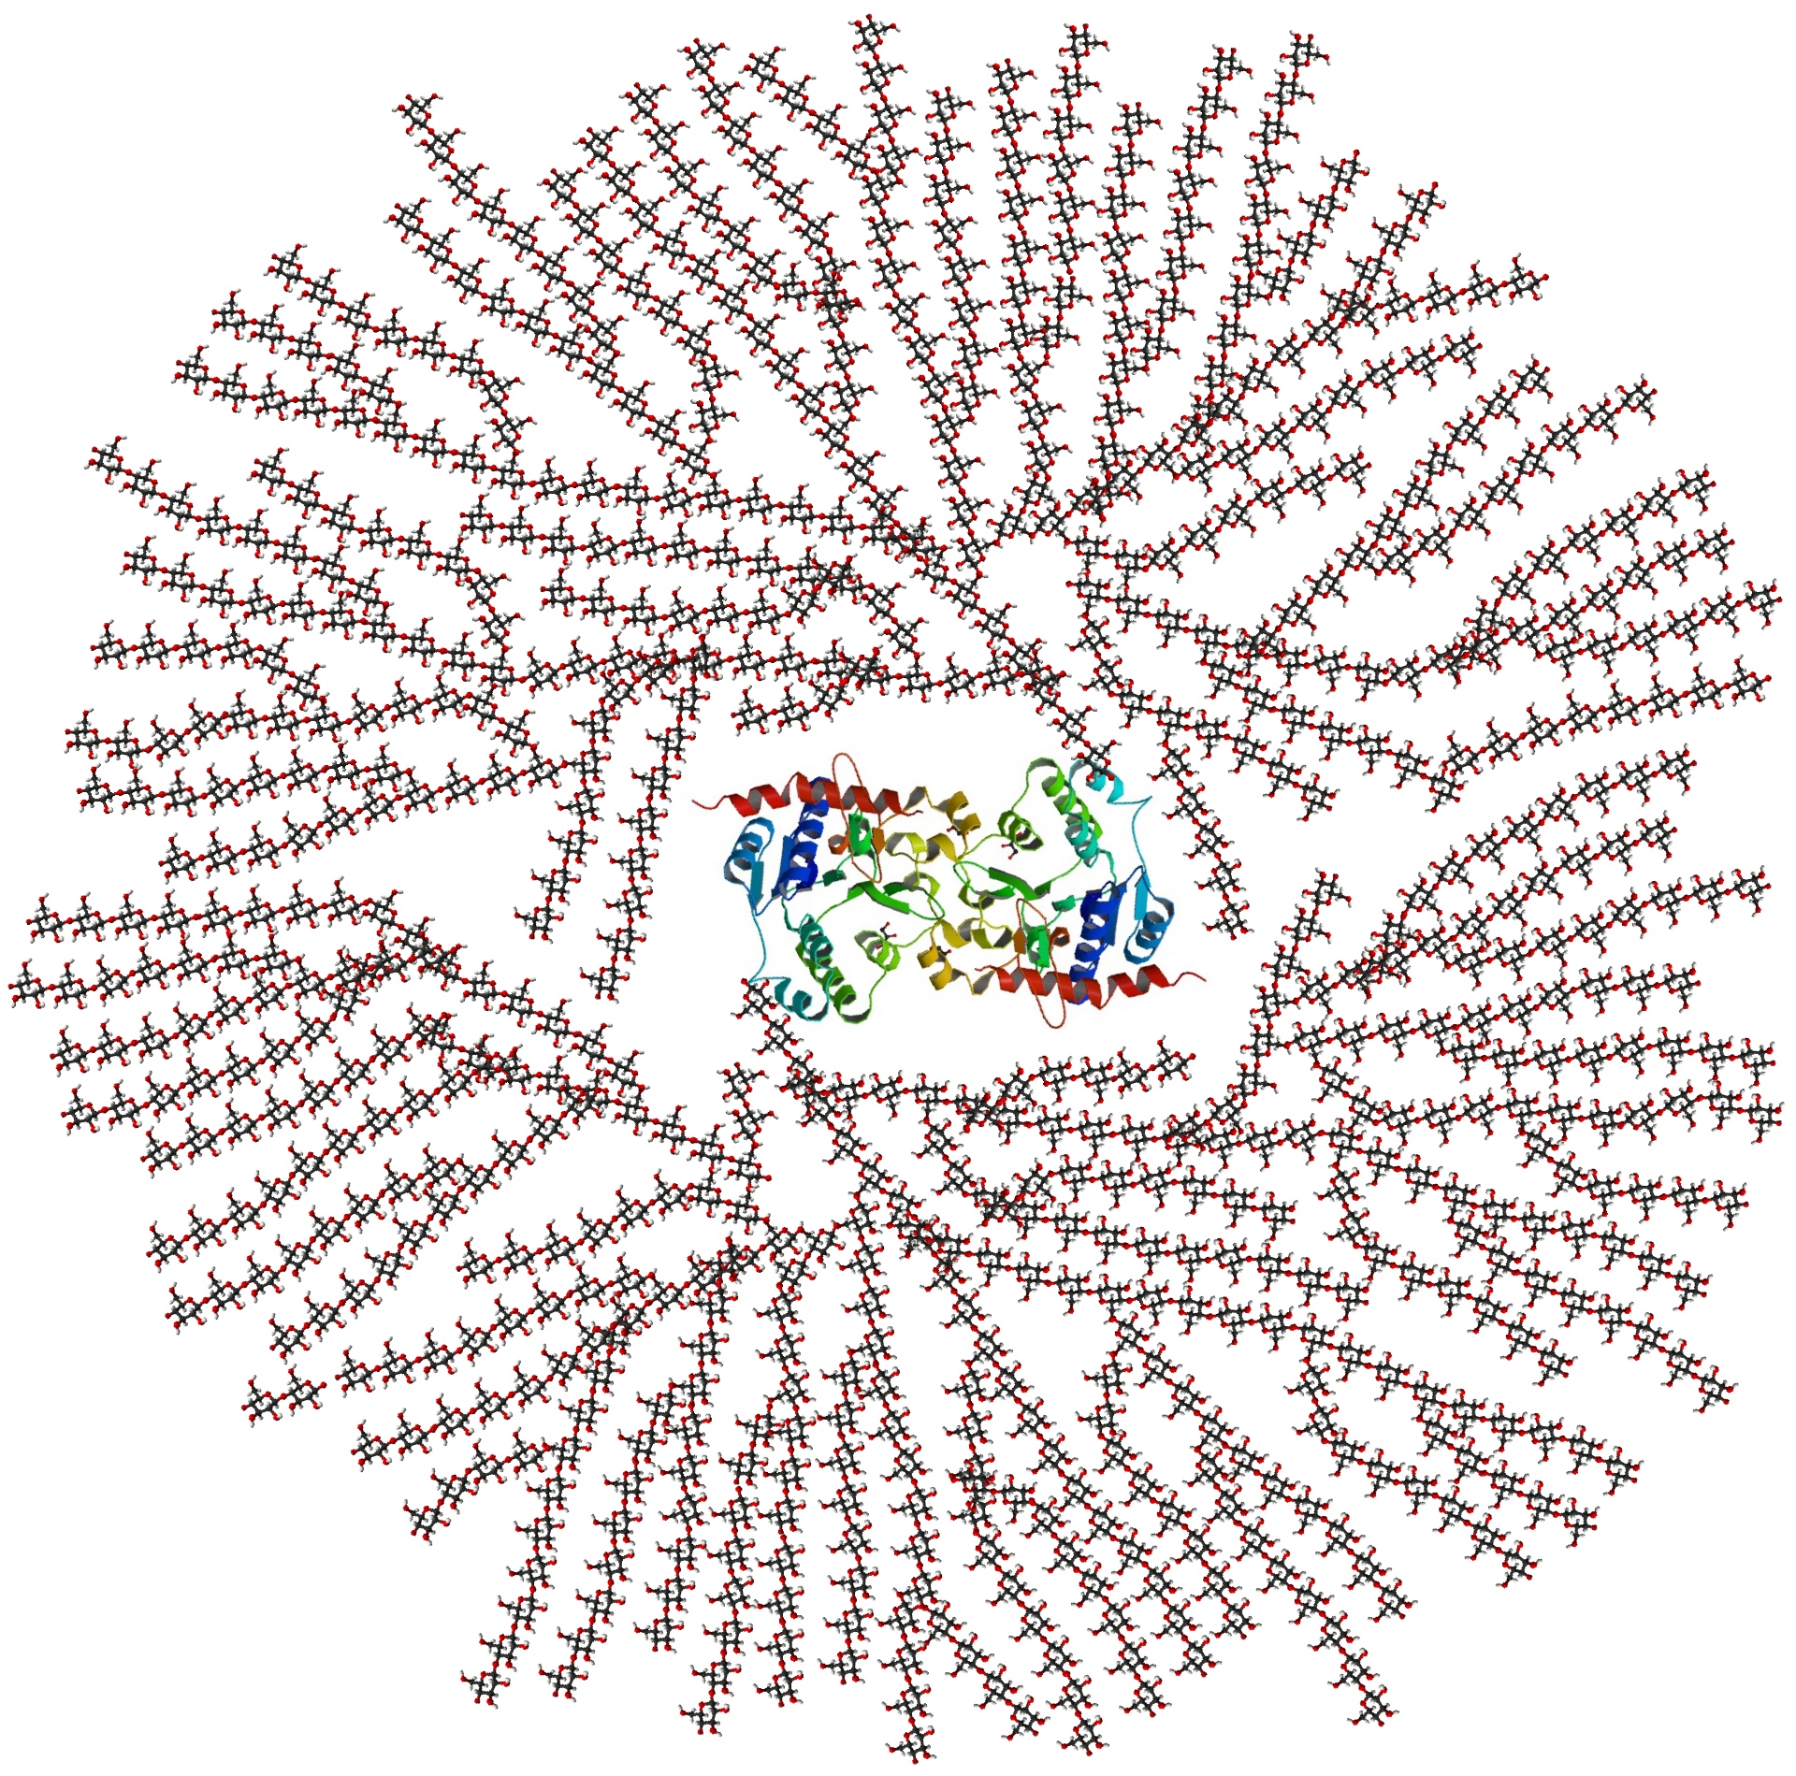
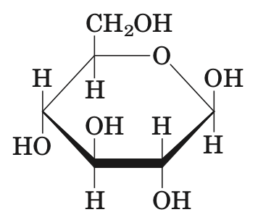
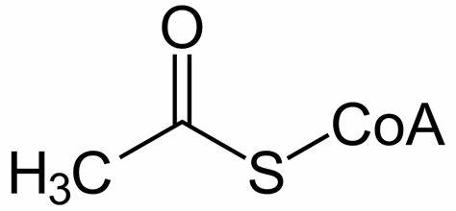
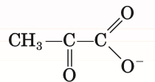

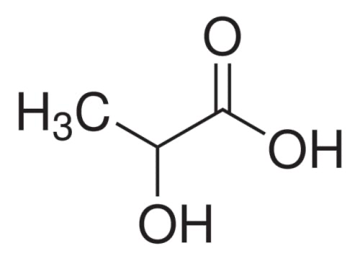
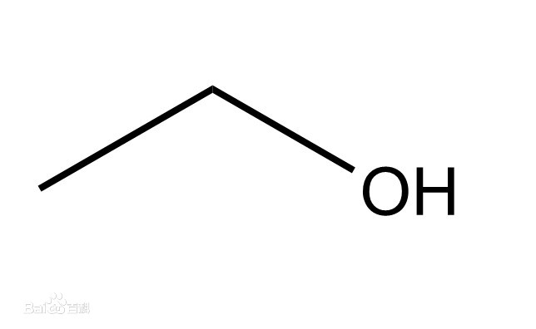
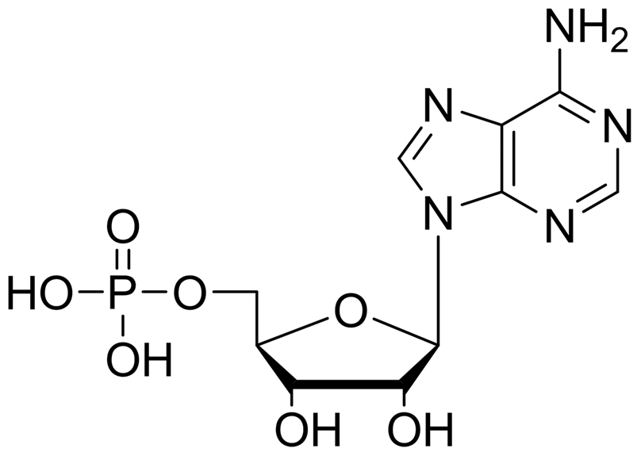
The degradation of carbohydrate
Oxidative decarboxylation of pyruvate
Glycogen
breakdown
Glycolysis
Acetyl-CoA
Pyruvate
Pyruvate
Glucose
Glycogen
Entry of some
other carbohydrates
CO2
oxaloacetate
CO2
Fermentation
citrate
the pentose phosphate
pathway
Citric acid cycle
ɑ-ketoglutarate
lactic acid
CO2
succinyl-CoA
ethyl + CO2
Ribose-5-phosphate
Notes:
Oxidative~:p18
Glycolysis:p8
Entry~:p13
Glycogen breakdown:p2
The pentose~:p31
Fermentation:p28
Citric~:p17

Slide 5
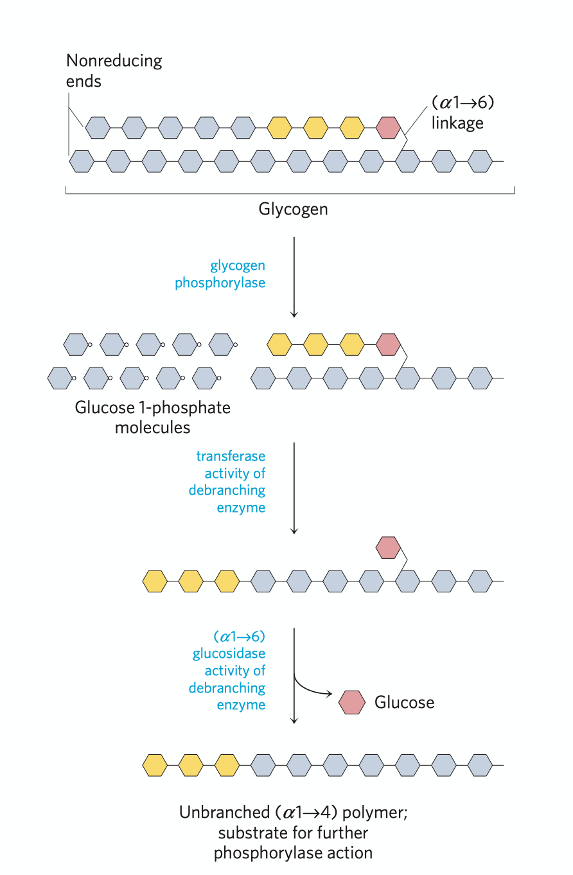
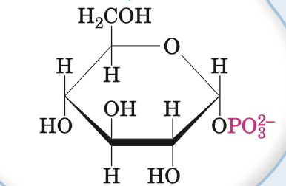
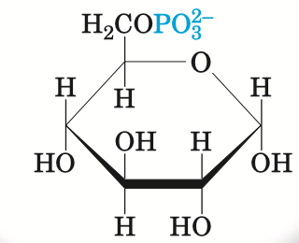
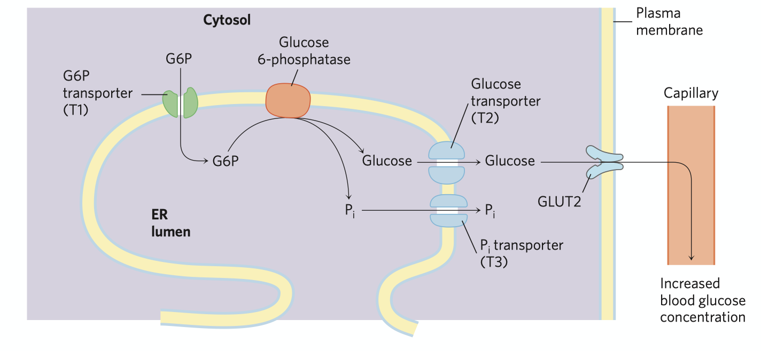

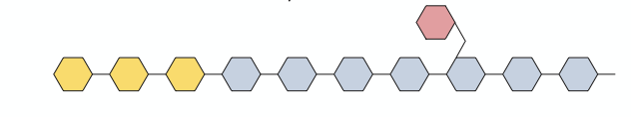
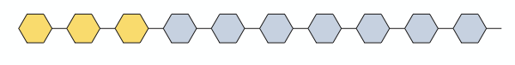
Glycogen breakdown
Glucose-1-phosphate
Glucose-6-phosphate
glycogen phosphorylase
phosphoglucomutase
(tranferase activity)
debranching enzyme
Glucose-6-phosphotase
(glucosidase activity)
debranching enzyme
Notes:
Glycogen phosphorylase:p3
Debranching enzyme:p5
Phosphoglucomutase:p6
Glucose-6-phosphatase:p7
Return:p1

Slide 6
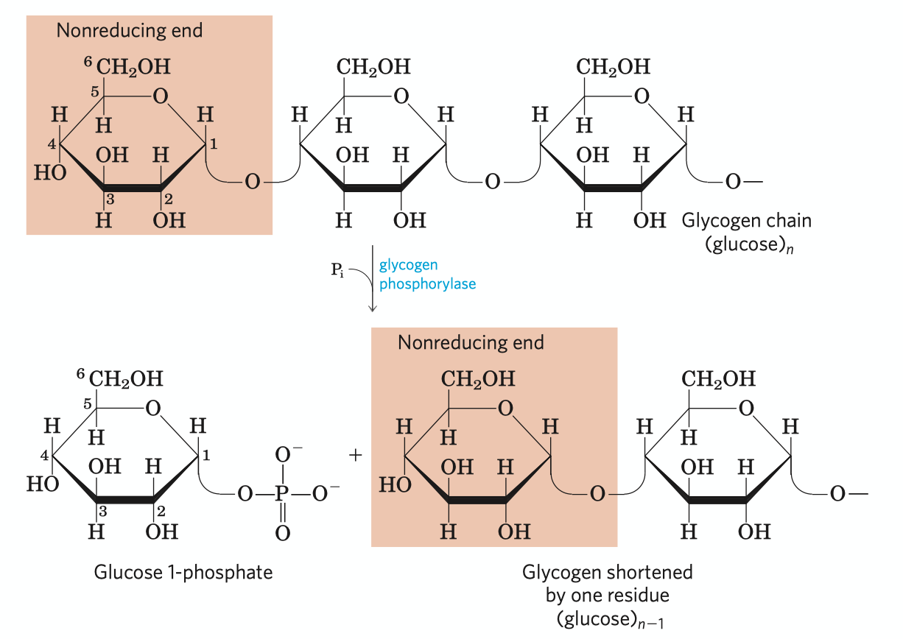
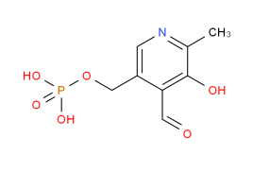
Removal of glucose residue: phosphorolysis
Glycogen phosphorylase catalyzes the reaction in which an ɑ1-4 between two glucose residues at a non-reducing end of glycogen undergoes attack by Pi, removing the terminal glucose residue as glucose-1-phosphate.
This enzyme is regulated by phosphrylation.
Pyridoxal phosphate acts as an acid catalyst by its phoshate group
pyridoxal phosphate
(cofactor)
Notes:
Return:p2

Slide 7
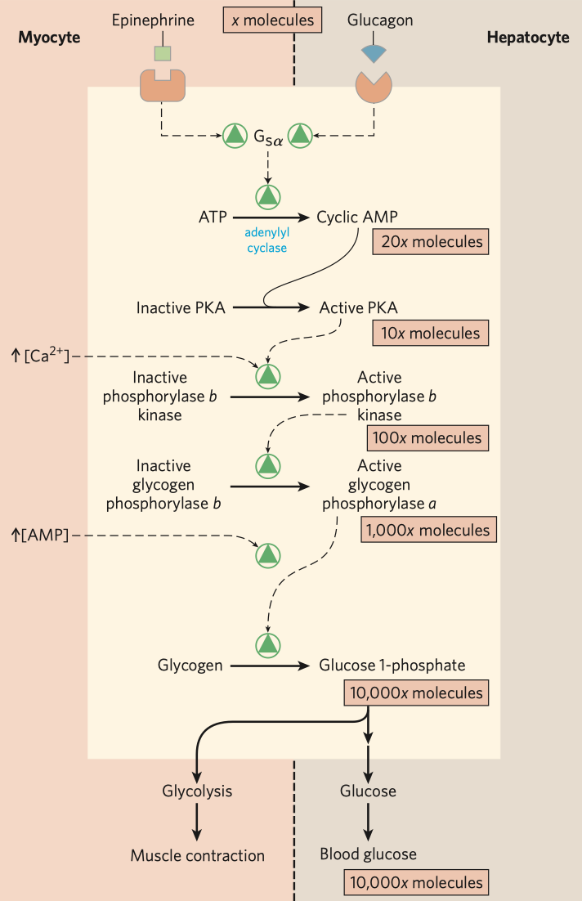
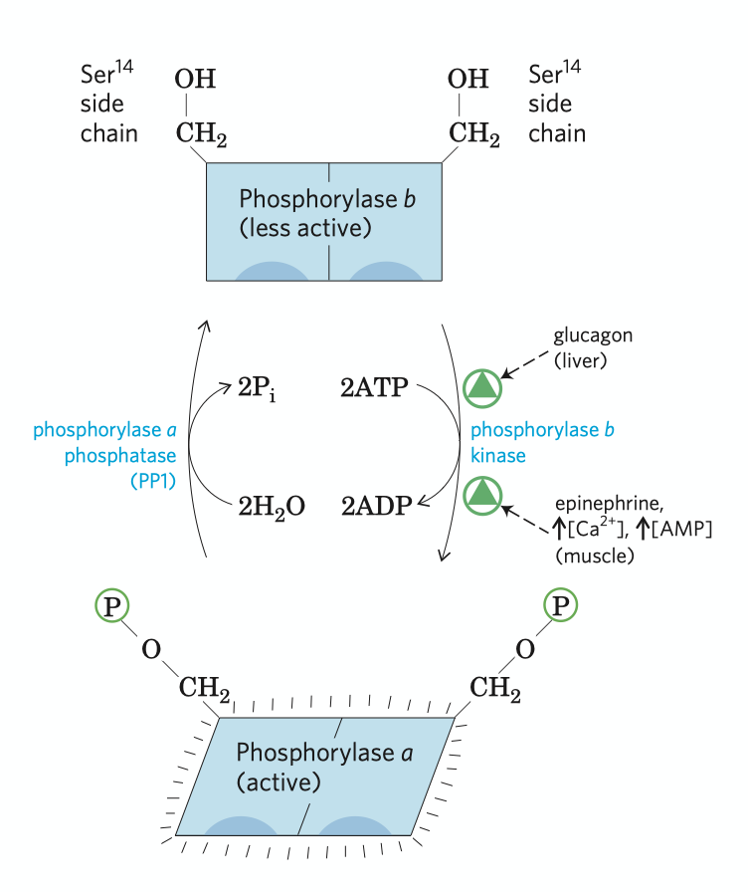
Regulation of muscle glycogen phosphorylase
Glycogen phosphorylase in skeleten muscle exists in two forms: a form (active) and b form (less active)
Elevated cAMP level in response to stimulation by epinephrine (in muscle) or by glucagon (in liver) stimulates PKA, which then phos-phorylates and activates phosphorylase b kinase to phosphrylate phosphorylase b and activates it
When muscle returns to rest, another enzyme, phosphory-lase a phosphotase removes the phosphate group in the phosphorylase a molecule and converts it to the b form, which is less active
The machenism shown left is called enzyme cascade
Notes:
Return:p2

Slide 8
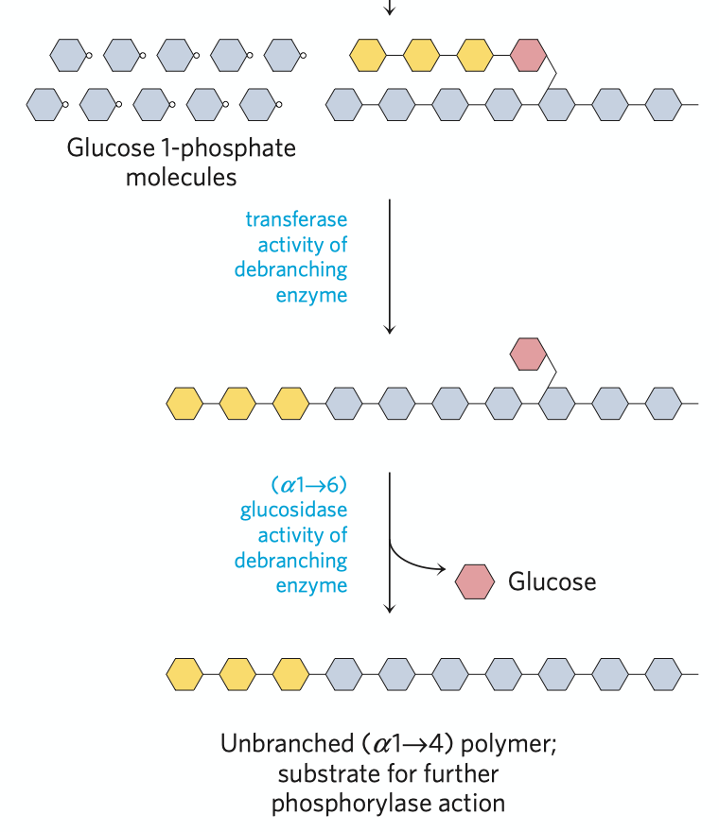
Function of debranching enzyme
Debranching enzyme
two acticities both essential to glycogen breakdown
Tranferase activity
Glycogen phosphorylase stops functioning when reaching a point four residues away from a branching point, then the debranching enzyme shifts a block of three residues from the branch to a nearby non-reducing ends by ɑ1-4 linkage.
Glycosidase activity
After removing the three residues, the enzyme still remaining at the branching point then released the single glucose residue as free glucose by hydrolysis, which attaches to the glycogen backbone by ɑ1-6 linkage.
Notes:
Return:p2

Slide 9
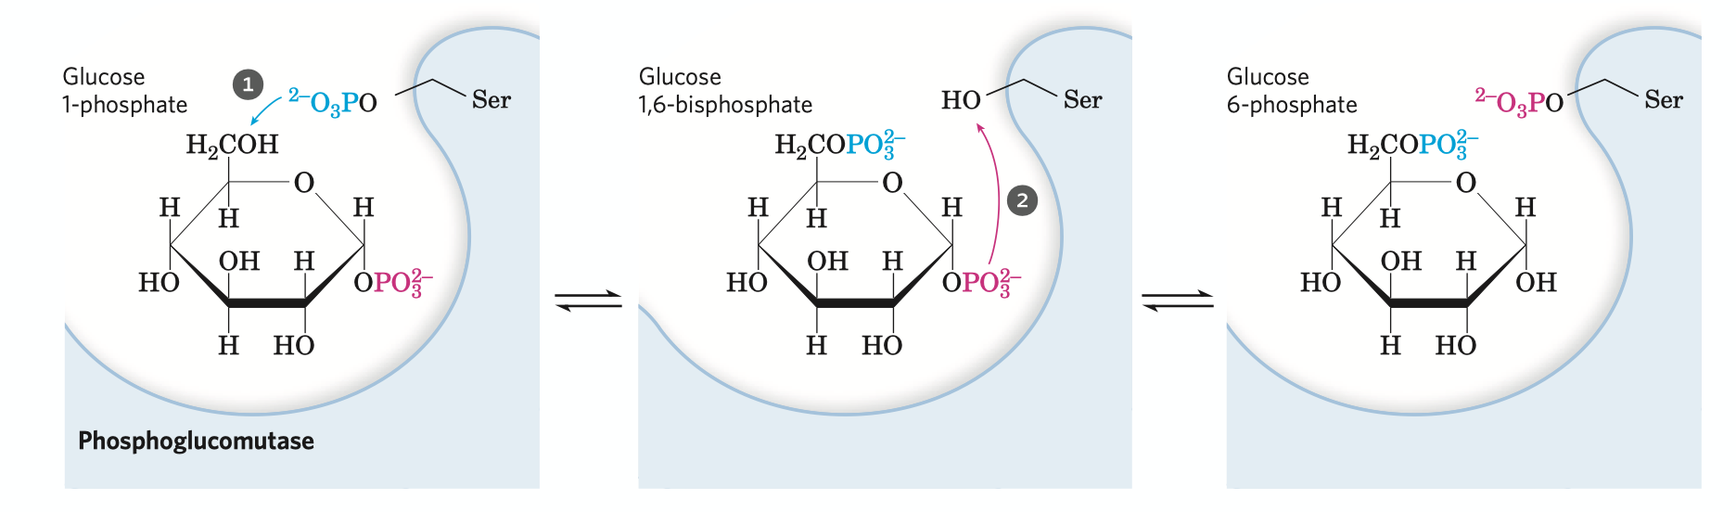
Catalyzing mechanism of phosphoglucomutase
In order to enter the glycolysis pathway, glucose-1-phosphate needs to be converted to glucose-6-phosphate, which is catalyzed by phosphoglucomutase.
The enzyme donates a phosphate group at a Ser residue to C-6 of the substrate, forming a intermediate, glucose-1,6-bisphosphate.
The enzyme then receive the phosphate group at C-1 of the glucose, reforming the phosphoenzyme.
Notes:
Return:p2

Slide 10
Glucose-6-phosphatase
Why glycogen stored in skeletal muscle can not replenish blood glucose?
Glycogen stored in skeletal muscle and liver serves different purposes. The former serves as energy source only for muscle contraction, while the latter is aimed to regulate the blood glucose level while it drops.
As a result, only in liver cells glucose-6-phosphatase occurs and can glycogen replenish blood glucose.
Why in endoplasmic reticulum membrane?
Glucose-6-phosphatase is an integral membrane protein of the endoplasmic reticulum membrane. Having its hydrolase activity at the lumenal surface, the reaction is positioned inside ER, separated from its coordinated reaction in glycolysis, which efficiently avoids futile cycle.
Related metabolism deficiency
Carrying such important function, genetic defects of this enzyme can cause serious metabolism deficiency, such as type Ia glycogen sotrage disease.
Notes:
Return:p2

Slide 11
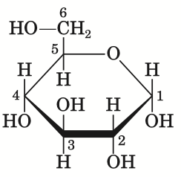
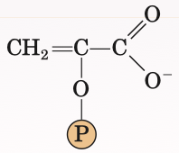
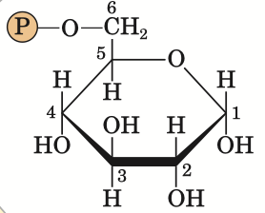
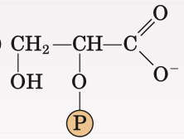
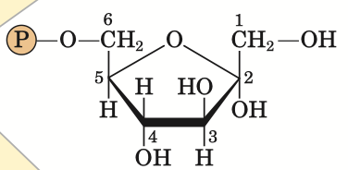
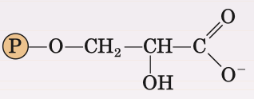
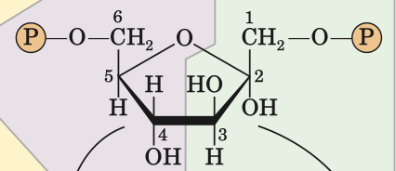
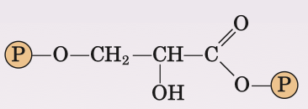


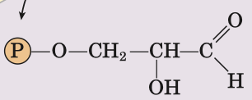
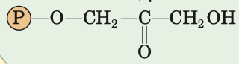
Glycolysis
pyruvate
glucose
ATP
ATP
pyruvate kinase
hexokinase
ADP
preparatory phase
ADP
phosphoenolpyruvate
payoff phase
glucose-6-phosphate
enolase
phosphohexose
isomerase
2-phosphoglycerate
phosphoglycerate
mutase
fructose-6-phosphate
3-phosphoglycerate
ATP
phospho
-fructokinase-1
phosphoglycerate
kinase
ATP
ADP
ADP
froctose-1,6-biphosphate
1,3-bisphosphoglycerate
NADH H+
aldolase
glyceraldehyde 3-phsophate
dehydrogenase
NAD+
glyceraledehyde 3-phosphate
dihydroxyacetone phosphate
triose phosphate isomerase
some important figures
Notes:
Hexokinase:p9
Phospho-fructokinase-1:p10
Aldolase & triose~:p11
Pyruvate kinase:p12
Some important figures:p14
Preparatory phase:p15
Payoff phase:p16
Return:p1

Slide 12
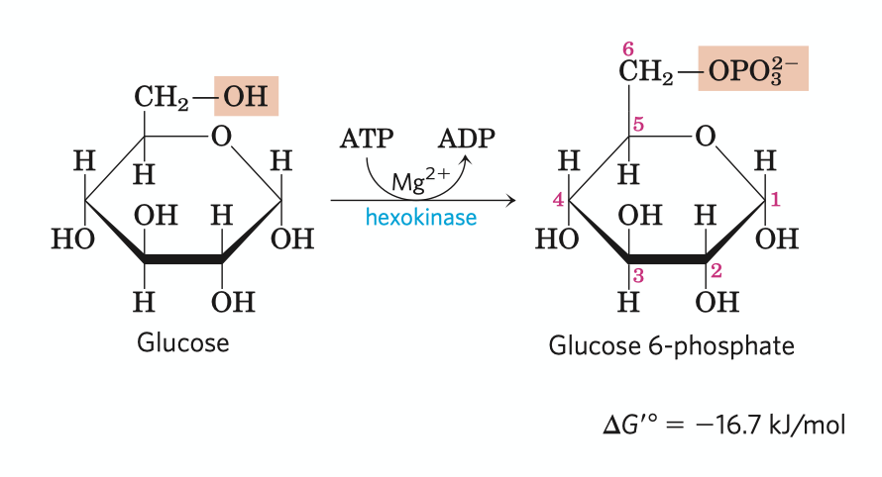
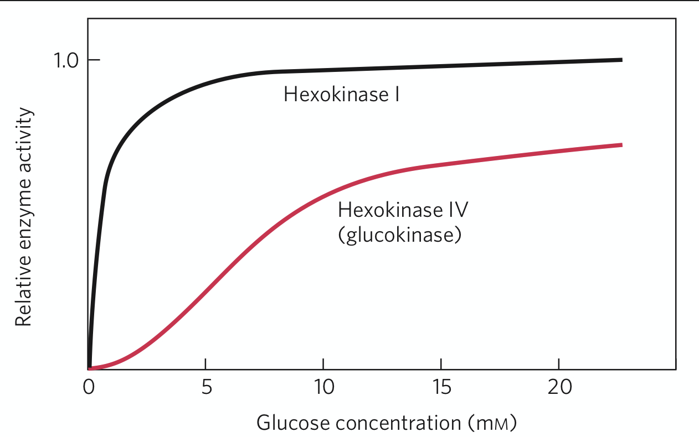
Phosphorylation of glucose
Irreversible
The reaction consumes an ATP
Requires Mg2+ for the kinase's activity (using MgATP2- but not ATP4- as substrate)
Hexokinase has four isozymes, among which the fourth one in hepatocytes (glucokinase) has many unique characteristics, such as extremely high Km and resistence to G-6-P inhibition
Notes:
Return:p8

Slide 13


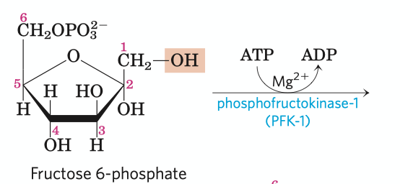
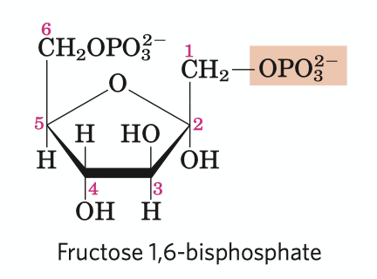
Phosphorylation of fructose phosphate
irreversible (key site for regulation)
the first “commited” reaction in the glycolytic pathway former chemicals has other fates, but 1,6-FBP is targeted for glycolysis
some bacteria and protists, perhaps all plants use bisphosphate instead of ATP as the phosphoryl group donor
PFK-1 undergoes complex allosteric regulation
ADP
AMP
fructose-2,6-bisphosphate
ATP
Ribulose-5-phosphate
Notes:
Return:p8

Slide 14
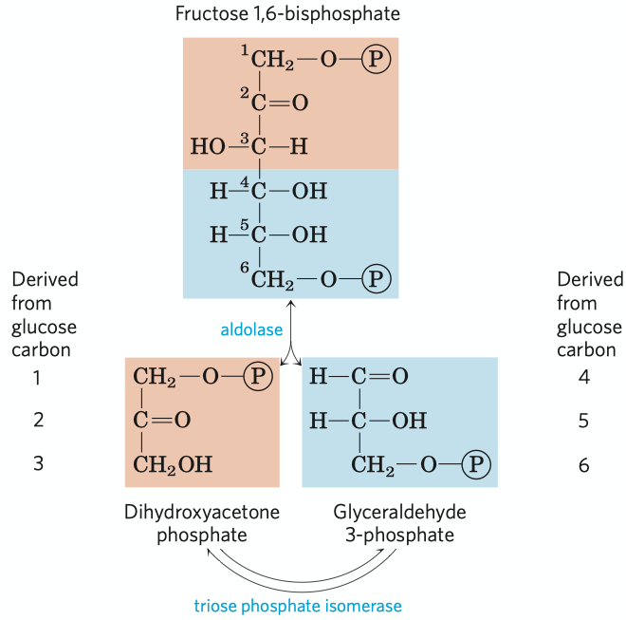
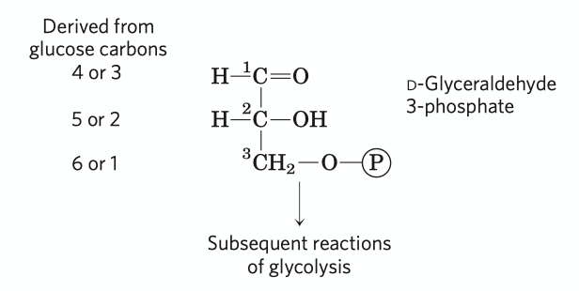
Fate of the glucose carbons
Just remember the phosphorylated carbons (C-1 and C-6 in hexose) remain phosphorylated in the triose (C-3)
After the triose isomerase reaction, the carbon atoms derived from C-1, C-2 and C-3 of the starting glucose cannot be chemically distinguished from the C-6, C-5 and C-4, coordinatedly.
Notes:
Return:p8

Slide 15
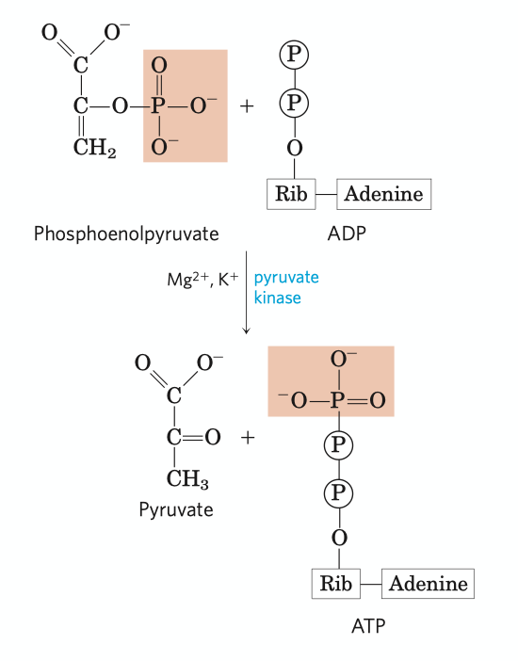
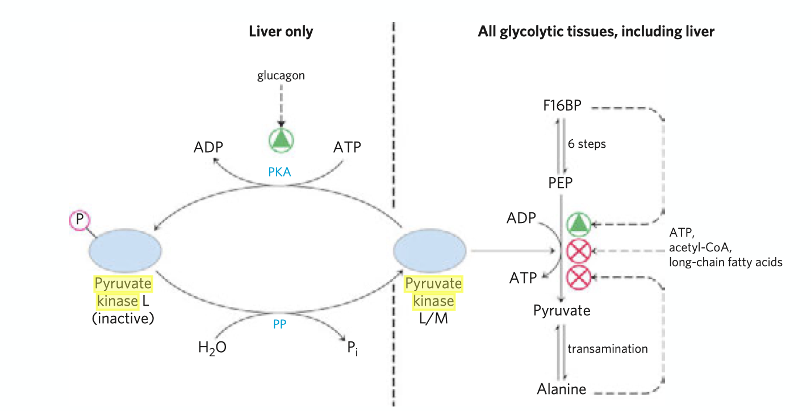
Pyruvate kinase
Irreversible
Pyruvate kinase requires K+ and either Mg2+ or Mn2+
The product pyruvate first appears in its enol form, then tautomerizes rapidly and nonenzymeticly to its keto form, which predominates at neutral pH
Pyruvate kinase is under tight regulation
High concentrations of ATP, acetyl-CoA and long-chain fatty acids can allosterically inhibit all isozymes
The liver isozyme is subject to phos-phorylation regulation, which occurs when glucagon is excreted
Notes:
Return:p8

Slide 16
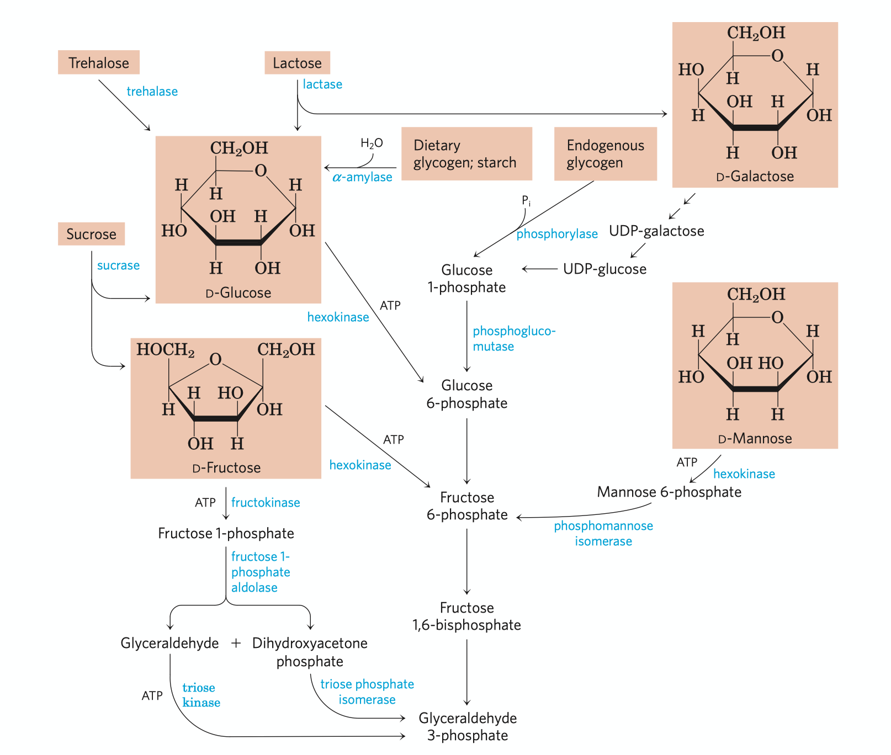
Entry of some other carbohydrates
Notes:
Return:p8

Slide 17
Some important figures of glycolysis
pyruvate
pyruvate
pyruvate
glucose
glucose
glucose
ATP
ATP
ATP
ATP
ADP
ADP
ADP
ADP
phosphoenolpyruvate
net energy change:
- 2ATP + 4ATP + 2NADH
(1NADH = 2.5 ATP)
= 7ATP/Glucose
phosphoenolpyruvate
phosphoenolpyruvate
glucose-6-phosphate
glucose-6-phosphate
glucose-6-phosphate
2-phosphoglycerate
2-phosphoglycerate
2-phosphoglycerate
fructose-6-phosphate
fructose-6-phosphate
fructose-6-phosphate
3-phosphoglycerate
ATP
3-phosphoglycerate
3-phosphoglycerate
ATP
ATP
ATP
ADP
ADP
ADP
ADP
froctose-1,6-biphosphate
froctose-1,6-biphosphate
froctose-1,6-biphosphate
1,3-bisphosphoglycerate
1,3-bisphosphoglycerate
1,3-bisphosphoglycerate
NADH H+
NADH H+
NADH H+
NAD+
NAD+
NAD+
glyceraledehyde 3-phosphate
dihydroxyacetone phosphate
glyceraledehyde 3-phosphate
glyceraledehyde 3-phosphate
Notes:
Return:p8

Slide 18
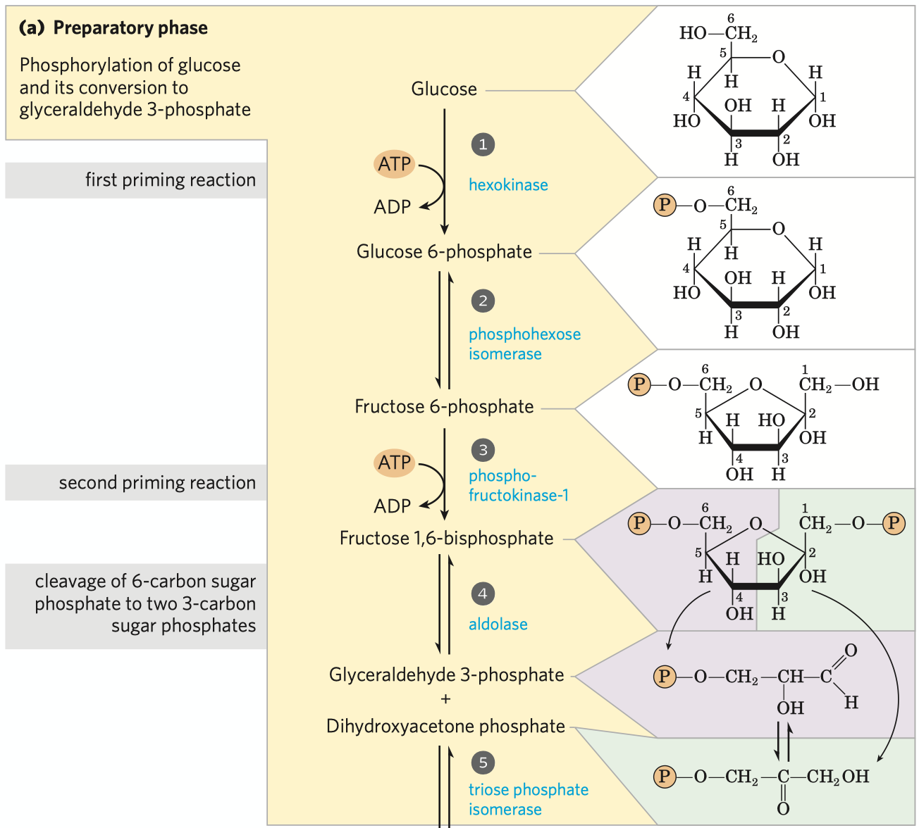
Preparatory phase
Two priming reactions in this phase, phosphorylation of glucose and phosphory-lation of F-6-P, each consumes an ATP.
In the preparatory phase of glycolysis, two ATPs are required for stimulation. No substrate level phosphorylation, no oxidative phosphorylation.
The hexose is finally hydrolyzed to two triose, glyceraldehyde 3-phosphate and dihydroxy-acetone phosphate after four steps.
Phosphorylation can retain the intermediates in cell, conserve energy in the formation of phosphate esters and activates the reactions by providing binding energy between phosphate groups and certain sites in the enzyme.
Notes:
Return:p8

Slide 19
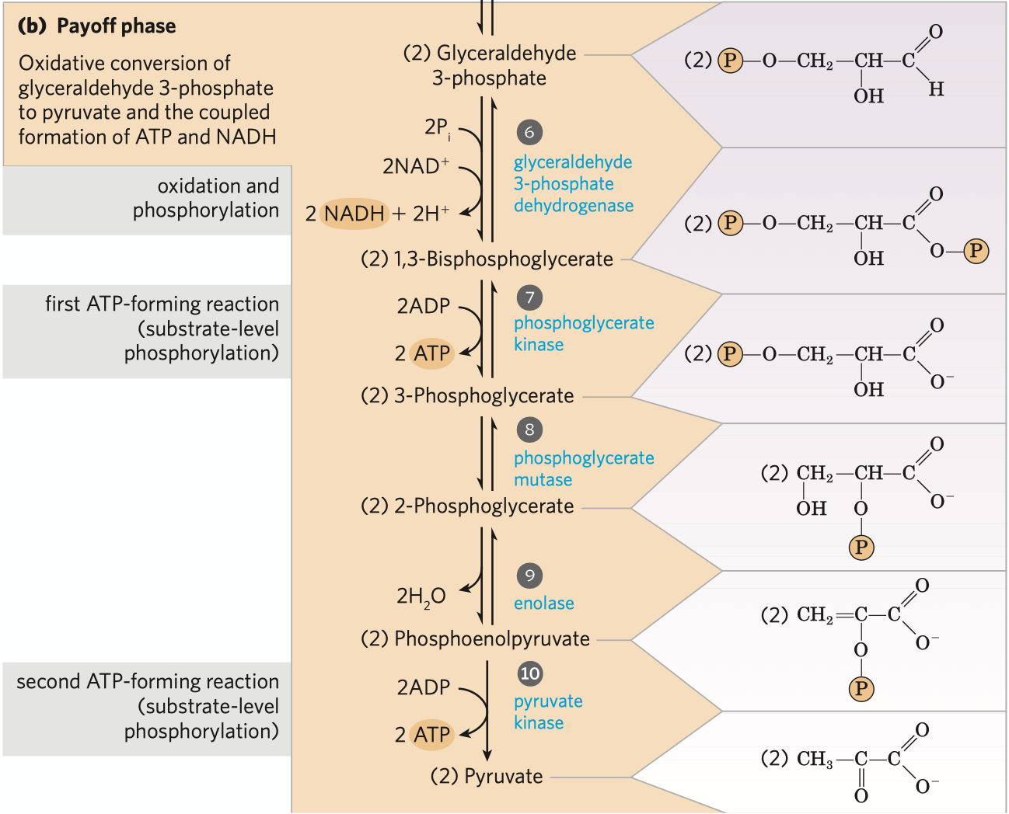
Payoff phase
Remember that one glucose has been converted to two glyceraldehyde-3-phosphate in the preparatory phase.
Each phospho-triose generates 2ATP and 1 NADH through two substrate level phosphorylation reactions and one dehydrogenation reaction.
Notes:
Return:p8

Slide 20



NADH
pyruvate dehydrogenase complex
Acetyl-CoA
NAD+
pyruvate
oxaloacetate
citrate synthase
malate dehydrogenase
citrate
malate
aconitase
fumarase
Citric acid cycle
isocitrate
fumarate
NAD+
isocitrate dehydrogenase
succinate dehydrogenase
NADH
FADH2
ɑ-ketoglutarate dehydrogenase complex
ɑ-ketoglutarate
CO2
succinyl-CoA
synthetase
succinate
FAD+
succinyl-CoA
GTP(ATP)
NAD+
GDP(ADP)
CO2
NADH
Notes:
pyruvate dehydrogenase complex:p18
Citrate synthase:p20
Isocitrate dehydrogenase:p21
a-ketoglutarate dehydrogenase complex:p22
Succinyl-CoA synthetase:p24
Succinate dehydrogenase:p25
Malate dehydrogenase:p26
Citric acid cycle:p27
Return:p1

Slide 21
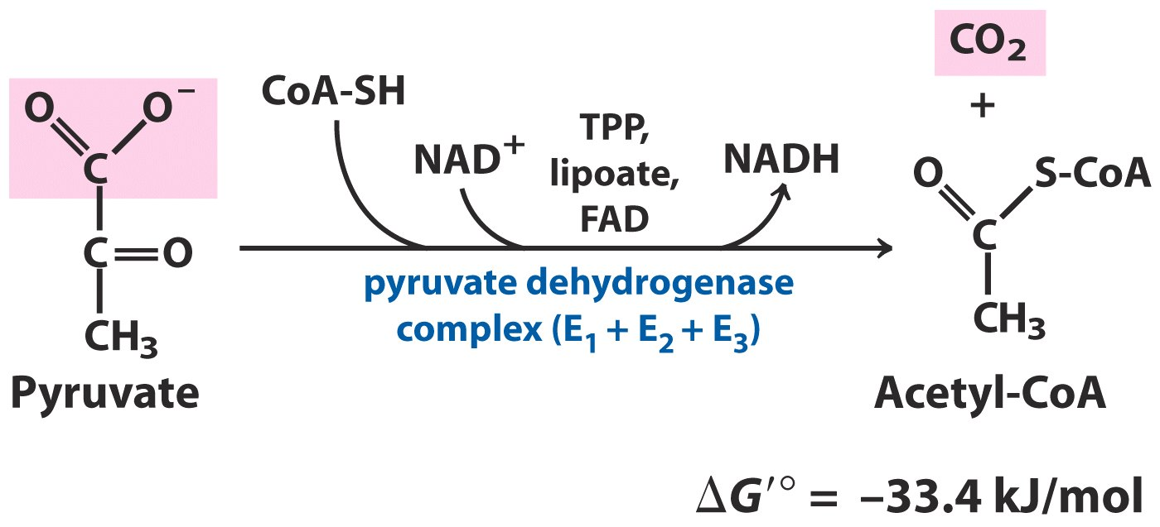
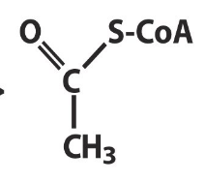
Decarboxylation of pyruvate
CoA-SH
acetyl carrier
NAD+
proton and electron carrier
proton and electron carrier
FAD
mechanism
proton and electron carrier
cofactors
proton and electron carrier
cofactors
cofactors
three enzymes:
E1 pyruvate dehydrogenase
E2 dihydrolipoyl transacetylase
E3 dihydrolipoyl dehydrogenase
TPP
carry hydroxyethyl group
carry hydroxyethyl group
lipoate
serves both as an electron
carrier and an acyl carrier
serves both as an electron
carrier and an acyl carrier
Acetyl-CoA is the central intermediate of catabolism, not only carbohydrate but also amino acids and fatty acids are first degraded to acetyl group of acetyl-CoA and then enter the ctric acid cycle for further degradation.
Notes:
Mechanism:p19
Return:p17

Slide 22
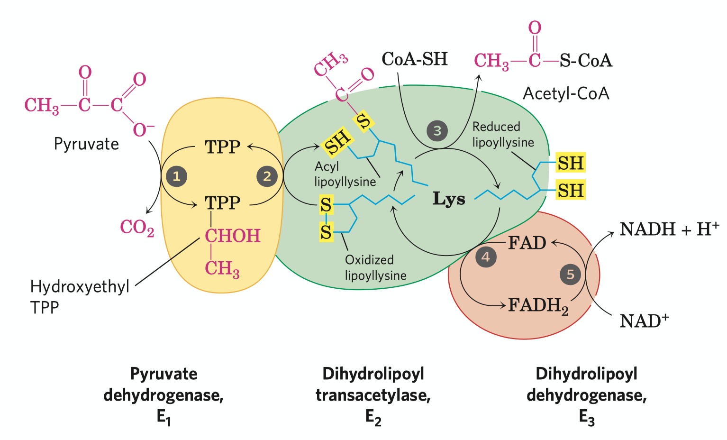
Mechanism of pyruvate decarboxylation
All the enzymes and coenzymes are clustered, allowing the intermediates to react quickly without diffusing away.
This mechnism is called substrate channeling
Notes:
Return:p17

Slide 23
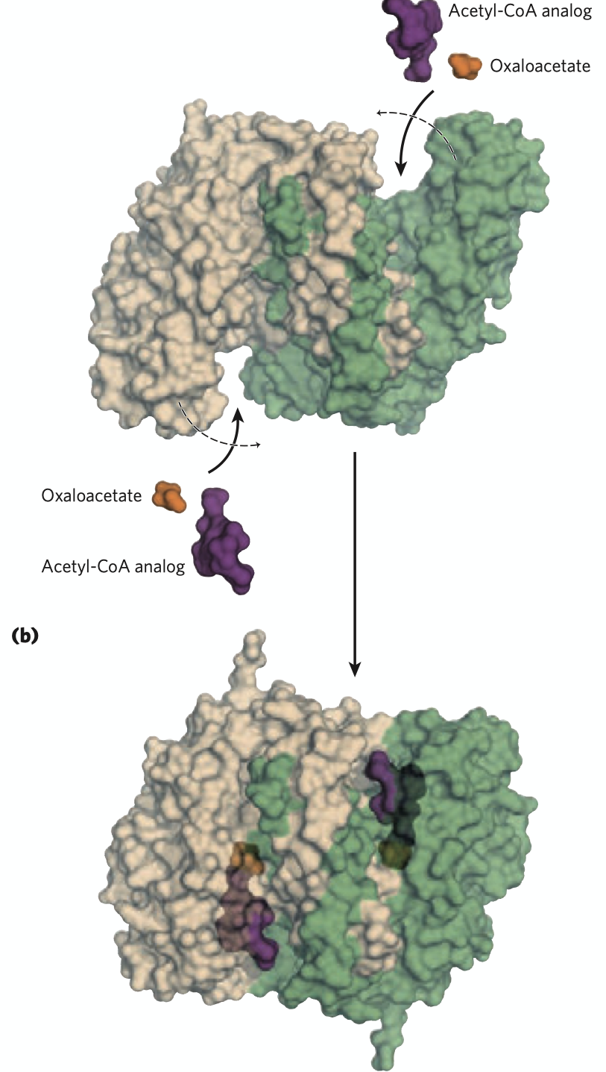
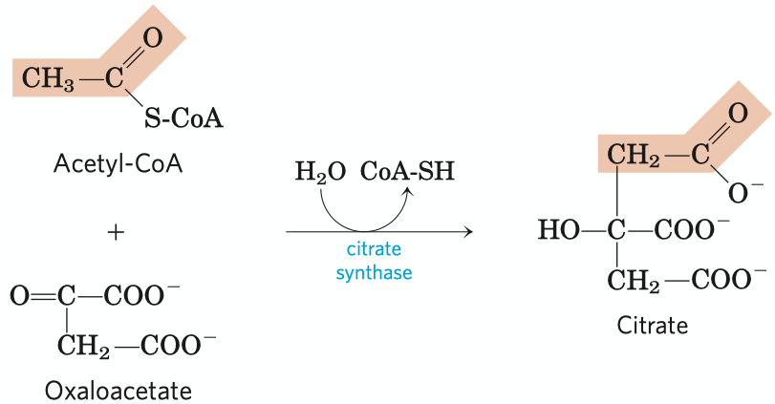
Formation of citrate
Irreversible (the first regulation site in citric acid cycle)
2C+4C=6C. The methyl carbon of the acetyl-CoA is joint to the carbonyl carbon(C-2) of the oxaloacetate. In other words, C1 and C2 of the newly formed citrate molecule is from acetyl-CoA.
The large free energy change is essential to the reaction, as [oxaloacetate] is really low.
Catalyzing mechanism: oxaloacetate binds to the enzyme first, creating a binding site for acetyl-CoA.
Notes:
Return:p17

Slide 24
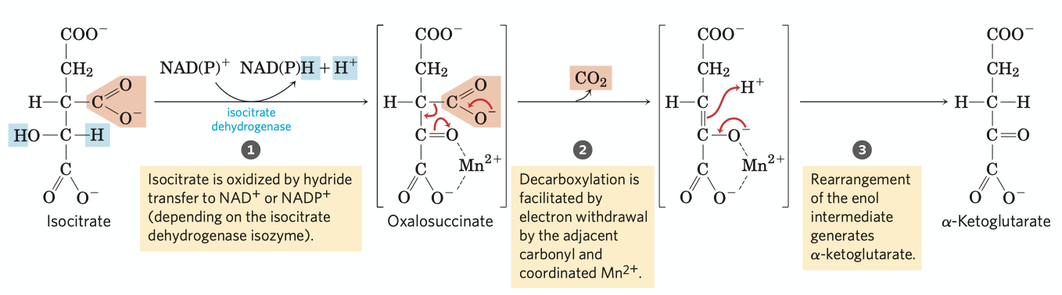
Oxidative decarboxylation of isocitrate
6C-1C = 5C.
First decarboxylation reaction in citric acid cycle, generating a NADH.
Catalyzed by isocitrate dehydrogenase, assisted by inorganic ion Mn2+.
There're two isoenzymes of isocitrate dehydrogenase in vivo, one using NAD+ as oxidative reagent, the other using NADP+.
Notes:
Return:p17

Slide 25
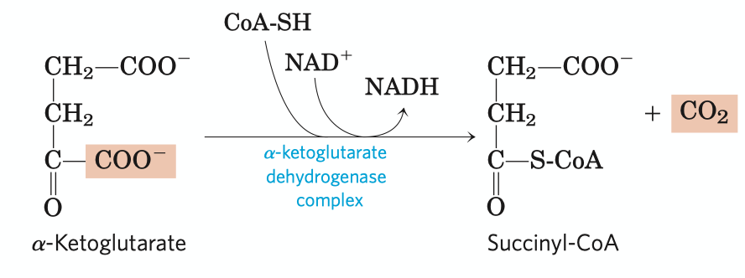
Oxidative decarboxylation of ɑ-ketoglutarate
An typical example of divergent evolution
a-ketoglutarate dehydrogenase complex
pyruvate dehydrogenase complex
branched-chain a-keto acid dehydrogenase
Irreversible
The second decarboxylation reaction of citric acid cycle, generating a NADH.
Catalyzed by a-ketoglutarate dehydrogenase complex, with NAD+ serving as electron acceptor and CoA-SH as succinyl group carrier.
Energy released from oxidation is stored in the thioester bond of succinyl group, which can be applied to the synthesis of ATP in the next reaction.
Notes:
An typical example of divergent evolution:p23
Return:p17

Slide 26
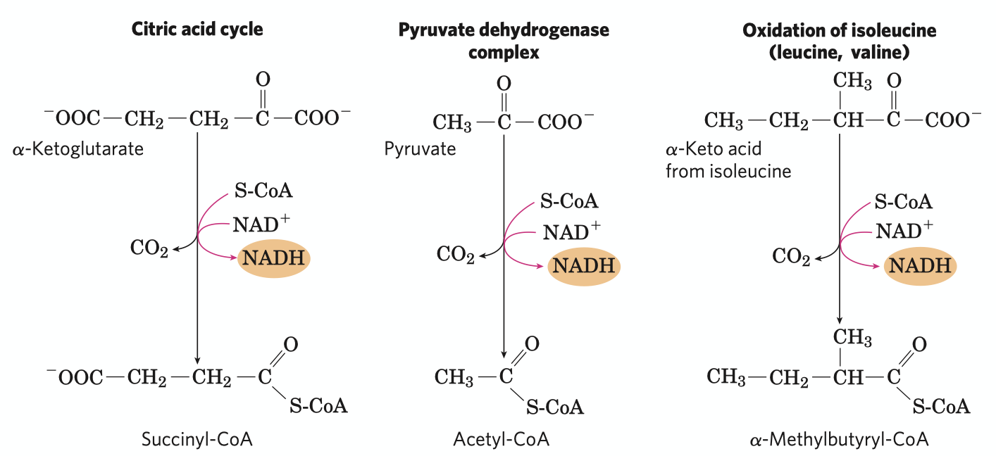
A conserved mechanism for oxidative decarboxylation
Three homologous enzymes
E1:
different amino sequence
different binding specificty
similar structure
E2:
similar tertiary structure
similar primary structure
E3:
identical
Similarities
Same reaction mechanism.
The cofactors needed are identical: TPP, lipoate, CoA-SH, NAD+ and FAD.
The three enzymes in the complex are respectively similar.
Notes:
Return:p22

Slide 27


Conversion of succinyl-CoA to succinate
A reversible substrate level phosphorylation reaction, the energy for ATP synthesis comes from the thioester bond in succinyl-CoA.
There're two isozymes of succinyl-CoA in vivo, one using GDP as substrate, another using ADP. As GTP can directly transfer its phosphate group to ADP, the net result of activities of each enzymes is the conservation of energy as ATP.
This reaction involves a phosphoenzyme intermediate.
Notes:
Return:p17

Slide 28

Oxidation of succinate
A reversible oxidation reaction, generating a FADH2 per succinate molecule, which energatically equals to 1.5 ATP in respiration-linked phosphorylation.
Catalyzed by succinate dehydrogenase, which is tightly bound to the mitochondrial inner membrane (plasma membrane in bacteria) as a member of the complex II in the electron transfer chain.
Can be inhibited by malonate, a strong competitive inhitor, also an analog of succinate.
Notes:
Return:p17

Slide 29

Oxidation of malate
The last step of citric acid cycle, catalyzed by malate dehydrogenase.
An irreversible oxidative reaction, generating a NADH.
Equilibrium of the reaction lies far to the left, but the continue removal of oxaloacetate drives the reaction to the right.
Notes:
Return:p17

Slide 30

Product of one turn of TCA cycle
One turn of cycle includes:
Two steps of decarboxylation (3rd and 4th)
Four steps of oxidation (3rd, 4th, 6th and 8th)
One step of substrate level oxidation
STEP | REDUCING COENZYME | ATP (GTP)
pyruvate acetyl-CoA | 1NADH
isocitrate a-ketoglutarate | 1NADH
a-ketoglutarate succinyl-CoA | 1NADH
succinyl-CoA succinate |  | 1A/GTP
succinate fumarate | 1FADH2
malate oxaloacetate | 1NADH
TOTAL | 4NADH + 1FADH2
Notes:
Return:p17

Slide 31


Fermentation
Under anaerobic condition, NADH generated from glycolysis maybe unable to be oxidized through the electron transfer chain. The lack of NAD+ would block the pathway, so our body passes the electrons to glycolysis products to regenerate NAD+. In such way, there're no net change of NAD+ number while two ATPs are generated through glycolysis.
Lactic fermentation exists in animals.
Ethanol fermentation exists in plants, yeasts and some other microorganisms.
Notes:
Lactic fermentation exists in animals:p29
Ethanol fermentation~:p30
Return:p1

Slide 32

Lactate fermentation
Reversible.
Usually in animal tissues, the electrons are directly passed to pyruvate and lactates are generated as the reducing products under anaerobic conditions.
Some tissues and cell types (such as erythrocytes, which has no mitochondria and thus cannot oxidize NADH) produce lactates even under aerobic conditions.
Lactate dehydrogenase has two forms, L form and M form. In most tissues like skeleton muscle and erythrocytes, the enzyme is in M form, catalyzing the reaction to the right. Generated lactates in this tissues can be carried through blood to liver, where the enzyme is in its L form and accelarates the reverse reaction to oxidize the lactates.
Notes:
Return:p28

Slide 33

Ethanol fermentation
Ethanol fermentation includes two reactions, a decarboxylation step and a reduction reaction.
The first step is a simple decarboxylation involcing no net oxidation of pyruvate catalyzed by pyruvate decarboxylase, generating acetaldehyde as well as releases a CO2. The enzyme is absent in vertebrate tissues and the organisms that carry lactate fermentation.
In the second step, the electrons of NADH is transferred to acetaldehyde to generate ethanol, catalyzed by alcohol dehydrogenase, which also exists in many organisms which do not carry ethanol fermentation but metabolize ethnol. However, in this organisms the reaction proceeds to the left.
Notes:
Return:p28

Slide 34

Pentose phosphate pathway
Nonoxidative phase
Oxidative phase
Pentose phosphate pathway is a fate of glucose-6-phosphate which gyields specialized products needed for cell growth.
Rapidly dividing cells, such as thosu of bone marrow, skin, and intestinal mucosa, and those of tumors, use pentose 5-phosphate to make RNA, DNA and coenzymes such as ATP, NADH.
NADPH generated in this pathway is needed for some other tissues for reductive biosynthesis or to counter the damaging effects of oxygen radicals.
There're two different types of pentose occurring in nature, the oxidative one and the reductive one, the former exists in most animal tissues and the latter occurs in plant tissues and is crucial to the photosynthetic assimilation of CO2.
Oxidative pentose phosphate pathway is divided into oxidative phase and nonoxidative phase .
Notes:
Nonoxidative phase:p32
Oxidative phase:p33

Slide 35


Oxidative phase
reaction equation of the oxidative phase
lactose
Mg2+
The net result of the oxidative phase is the production of NADPH, a reductant for biosynthetic reactions, and ribose 5-phosphate, a precursor for nucleotide synthesis.
Notes:
Return:p31

Slide 36

Nonoxidative phase
In the rapidly dividing cells, ribulose is further converted to ribose for nucleic acid synthesis. In tissues that primarily needs NADPH, the pentose would go into the nonoxidative phase and is converted to six-carbon sugar phosphates after a series of rearrangements of the carbon skeletons.
Many different sugar of different carbon numbers is generated in this phase.
Notes:
Return:p31

Slide 37

The synthesis of carbohydrate:
Gluconeogenesis, Photosynthesis and Glycogen synthesis
Pyruvate/lactate
glucagon
Insulin
Gluconeogenesis
Light
Glyoxylate cycle
Glycogen synthesis
Acetyl-CoA
Glucose
Glycogen
In plants
Photosynthesis
ATP
Calvin Cycle
NADPH + H⁺

Slide 38
Gluconeogenesis
Pyruvate
Lactate
Pyruvate
Pyruvate
CO₂
Pyruvate
ATP
Pyruvate carboxylase
CO₂
ADP+Pi
ATP
Pyruvate carboxylase
Oxaloacetate
ADP+Pi
NADH+H⁺
Mitochondrial
Malate dehydrogenase
Oxaloacetate
NAD⁺
GTP
Mitochondrial PEP carboxykinase
Glucose
Malate
GDP+Pi
CO₂
PEP
Glucose
6-phosphatase
Malate
NAD⁺
Cytosolic
Malate dehydrogenase
Glucose 6-phosphate
NADH+H⁺
Oxaloacetate
PEP carboxykinase
Fructose 1,6-phosphatase
GTP
PEP
Gluconeogenesis
Fructose 1,6-biphosphate
GDP+Pi
CO₂
Glycolysis

Slide 39


Pyruvate carboxylase
Pyruvate carboxylase: the first regulatory enzyme in gluconeogenesis, requires acetyl-CoA as a positive effector
Biotin is a crucial part of carboxylase, which carries carboxyl group and transport it to substrate. In this process, one unit of ATP is consumed.
https://en.wikipedia.org/wiki/Pyruvate_carboxylase

Slide 40

PEP Carboxykinase
This enzyme located both in cytosol and mitochondria. If the material of gluconeogenesis is lactate, oxaloacetate is converted to PEP in mitochondria, because the oxidation of lactate will release NADH in the cytosol. Therefore, cell doesn’t need bring NADH out of mitochondria by malate.

Slide 41


Glucose 6-biphophatase
This enzyme catalyzes one important irreversible reaction --- from glucose 6-phosphate to glucose, which makes the final product of gluconeogenesis can be released in blood.
The enzyme is a membrane protein located in endoplasm reticulum. However, it is absent in muscle cells, because glucose in muscle is mainly consumed by itself whereas hepatocyte should release glucose in blood to regulate blood glucose concentration.

Slide 42


Fructose 1,6-phosphatase and PFK-2
Fructose 1,6-biphosphate
Fructose 1,6-phosphatase
Fructose 6-phosphate
Fructose 2,6-biphosphate plays a central role in the regulation of gluconeogenesis and glycolysis. PFK-2 is a single enzyme which contains two reverse activity, kinase and phosphatase activity. Insulin and glucagon regulate the relative activity of PFK-2 reversible phosphorylation.
Some details are showed in the figure.
Pi
Fructose 2,6-phosphate
PFK-2
activity
Fructose
2,6-biphosphatase activity
Insulin
Glucagon
Fructose 6-biphosphate

Slide 43










Reverse Process of Glycolysis
Mg²⁺
Mg²⁺
Mg²⁺
Mg²⁺
+
H₂O
ATP
ADP+Pi
Pi
PEP
2-phosphoglycerate
3-phosphoglycerate
1,3-phosphoglycerate
3-PGAld
Mg²⁺
Pyruvate
Pi
Glucose
Glucose 6-phosphate
Fructose 6-phosphate
Fructose 1,6-phosphate

Slide 44

Glyoxylate Cycle
In animal cell, glucose cannot be synthesized from acetyl-CoA. In this case, it is impossible for animal to convert fatty acid to glucose. However, in some kind of seed, with the existence of glyoxysome and isocitrate lyase, acetyl-CoA can be the material of gluconeogenesis.

Slide 45



Synthesis of Glycogen
Phosphoglucomutase
Glucose 6-phosphate
Glucose 1-phosphate
UDP-glucose pyrophosphorylase
UDP-Glucose
+
Nonreducing end of glycogen with n residues
Branched Glycogen
Glucose synthase
glycosyl-(4→6)-transferase
Glycogen with n+1 residues

Slide 46


Reactions in Glycogen Synthesis
Phosphoglucomutase
UDP-glucose pyrophosphorylase

Slide 47


Properties of Glycogen Synthase
1. The beginning of glycogen synthesis need a particular protein called glycogenin, which contains a Tyr residue to accept first glucose residue.
2. Regulation of glycogen synthase:
When which is phosphorylated, its activity is inhibited whereas when dephosphorylated, it is activated. This reversible phosphorylation is regulated by PP1 (Phosphoprotein phosphatase) and GSK3 (Glycogen Synthase Kinase).

Slide 48

Photosynthesis
In the photosynthesis, energy in light is stored in NADPH and ATP. In further carbon reaction, the energy and reducing power will be used to fix CO₂ and synthesis carbohydrate.
8 photons + 2H₂O → 4H⁺ + O₂ + 2NADPH + 3ATP
Two Photosystems
Synthesis of ATP
Pigments

Slide 49




Photosynthesis Pigments
Only the special chlorophyll a pair can transfer electrons, which is called “Reaction Centre Pigments”.
Other pigments are “accessory pigments” that collect energy.

Slide 50


Two Photosystems
PSII:
The photolysis of water provide electrons to the electron transferring chain. Proton is released to generate proton gradient cross thylakoid membrane.
PQ_{B} also brings proton to thylakoid lumen.
PSI:
Electrons are finally transported to NADP⁺, which would act as the reducing power to fix CO₂.

Slide 51

ATP-synthesis --- Photophosphorylation
Which is quite similar mechanism to oxidative phosphorylation in mitochondria

Slide 52
Calvin Cycle
CO₂
Ribulose 1,5-biphosphate
Rubisco
ADP+Pi
ATP
Carbon fixation
3-phosphoglycerate
ATP
Ribulose 5-phosphate
ADP+Pi
Reduction
1,3-biphosphoglycerate
RuBP Synthesis
NADH+H⁺
3-phosphoglycealdehyde
NAD⁺
3CO₂ + 9ATP + 6NADPH
glyceraldehyde 3-phosphate+ 9ADP + 8P_{i} + 6NADP⁺

Slide 53


Ribulose 1,5-biphosphate Carboxylase/Oxygenase
Rubisco is the most abundant protein in earth.
It contains 16 subunits.
Catalyze two different reaction:
Carboxylase: Calvin Cycle.
Oxygenase: Photorespiration.

Slide 54

Photorespiration
Photorespiration (also known as the oxidative photosynthetic carbon cycle, or C2 photosynthesis) refers to a process in plant metabolism where the enzyme Rubisco oxygenates RuBP, wasting some of the energy produced by photosynthesis.

Slide 55
The metabolic pathway of lipids
glycerophospholipids
Synthesis of glycerophospholipids
Synthesis of triacylglycerols
Synthesis of eicosanoid
Mobilization
stored
Eicosanoid
Fatty acids
Triacylglycerol
Leukotrienes
Digestion and transport
dietary
Synthesis of leukotrienes
Fatty acid
synthesis
β-Oxidation
Ketone bodies synthesis
Cholesterol synthesis
Ketone bodies
Acetyl-CoA
Cholesterols
Ketone bodies breakdown
Notes:
Arrow——general view
synthesis of glycerophospholipids——slide 16
Synthesis of triacylglycerols——slide 16
Synthesis of eicosanoid——slide 17
Synthesis of leukotrienes——slide 18
Beta-oxidation——slide 4
Fatty acid synthesis——slide 9
Ketone bodies synthesis——slide 8
Ketone bodies breakdown——slide 8
Mobilization——slide 3
Digestion and transport——slide 2
Cholesterol synthesis——slide 19

Slide 56


Digestion and transport of dietary triacylglycerols
triacylglycerol
Intestinal lipase
Fatty acid
ApoC-II
Fatty acid
Fatty acid
glyceral
ApoC-II
lipoprotein lipase
triacylglyceral
Chylomicron
Glycolytic pathway
Notes:
Arrow——slide 1
Glycolytic pathway——glucose metabolism
fatty acid——slide 4

Slide 57

Mobilization of stored triacylglycerols
glucagon
epinephrine
Serum albumin
Fatty acid
triacylglyceral
Fatty acid
ATGL HSL MGL
Serum albumin
perilipin
Adipoctye
Notes:
Arrow——slide 1
Fatty acid——β-oxidation

Slide 58





β-Oxidation
Fatty acid
Malonyl-CoA
Fatty acyl-CoA synthetase
(fatty acid thiokinase)
Cholesterol biosynthesis
Fatty acyl-carnitine
Fatty acyl-CoA
CoA-SH
Carnitine acyltransferase II
Fatty acid biosynthesis
carnitine
Acyl carnitine/carnitine transporter
carnitine
Carnitine acyltransferase I
CoA-SH
Fatty acyl-CoA
succinyl-CoA
Fatty acyl-carnitine
FAD
acyl-CoA dehydrogenase
Carnitine
FADH2
trans-Δ²-Enoyl-CoA
Methylmalonyl-CoA mutase
The citric acid cycle
Η₂Ο
enoyl-CoA hydratase
coenzyme B12
L-methylmalonyl-CoA
L-β-Hydroxy-acyl-CoA
Ketone bodies synthesis
Methylmalonyl-CoA epimerase
NAD⁺
β-hydroxyacyl-CoA dehydrogenase
NADH+H⁺
D-methylmalonyl-CoA
β-Ketoacyl-CoA
ADP+Pi
propionyl-CoA carboxylase
CoA-SH
acyl-CoA acetyltransferase (thiolase)
HCO₃⁻
Biotin
ATP
propionyl-CoA or Acetyl CoA +
Fatty acyl-CoA
Notes:
Malonyl-CoA——slide 9
Carnitine transferase I——slide 6
Carnitine transferase II——slide 6
Coenzyme B12——slide 7
cholesterol biosynthesis——slide 19
Fatty acid biosynthesis——slide 9
The citrate acid cycle——citric acid cycle
ketone bodies synthesis——slide 8
Fatty acyl-CoA synthetase(fatty acid thiokinase)——slide 5
The citric acid cycle——the citric acid cycle
Arrow——slide 1

Slide 59


Fatty acyl-CoA synthetase
(fatty acid thiokinase)
Fatty acyl-CoA synthetase (fatty acid thiokinase):
a family of isozymes (different isozymes specific for fatty acids having short, intermediate, or long carbon chains) present in the outer mitochondrial membrane.
General reaction:
Fatty acid+CoA+ATP fatty acyl+CoA+AMP+PPi
Notes:
Arrow——slide 4

Slide 60


Carnitine acyltransferase I & II
Carnitine: binds to acyl groups via the hydroxyl group
Carnitine acyltransferase I:
Located on the outer membrane of mitochondria
Carnitine acyltransferase II:
Located on the inner membrane of mitochondria
The two CoA-SH pools are actually separated.
This entering step is the rate-limiting step for fatty acid oxidation.
Notes:
Arrow——slide 4

Slide 61

Coenzyme B12
Coenzyme B12 (cyanocobalamin):
Coenzyme B12 is the cofactor form of vitamin B12.
The complex corrin ring system of vitamin, to which cobalt (as Co³⁺) is coordinated, is chemically related to the porphyrin ring system of heme and heme proteins.
In 5’-deoxyadenosyl-cobalamin, the cofactor for methylmalonyl-CoA mutase, the cyano group is replaced C by the 5’-deoxyadenosyl group.
Catalyzes hydrogen exchange.
Notes:
Arrow——slide 4

Slide 62

Ketone bodies synthesis and break-down
2 acetyl-CoA
thiolase
CoA-SH
Acetoacetyl-CoA
2 acetyl-CoA
Acetyl-CoA+H₂O
HMG-CoA synthase
thiolase
CoA-SH
CoA-SH
β-Hydroxy-β-methylglutaryl-CoA
(HMG-CoA)
Acetoacetyl-CoA
HMG-CoA
lyase
β-ketoacyl-CoA transferase
Succinate
Acetyl-CoA
Succinyl-CoA
acetoacetate
acetoacetate
acetoacetate decarboxylase
D-β-hydroxybutyrate dehydrogenase
D-β-hydroxybutyrate dehydrogenase
Acetone
D-β-Hydroxybutyrate
NADH+H⁺
CO₂
NADH+H⁺
NAD⁺
NAD⁺
Notes:
Arrow——slide 1

Slide 63




Fatty acid synthesis
Citrate
The shuttle pathway
Acetyl-CoA
Unsaturated fatty acids
Long-chain fatty acids
CoA-SH
ATP
ADP+Pi
Oxaloacetate
HCO₃⁻
Fatty acid
elongation
acetyl-CoA carboxylase
(ACC)
ATP
Palmitoyl-CoA
biotin
acetyl-CoA-ACP transferase(AT)
ADP+Pi
Fatty acid desaturation
Malonyl-CoA
Palmitate
Glucagon, epinephrine
malonyl-CoA-ACP transferase(MT)
ACP-SH
Fatty acid synthase
CoA-SH
H₂O
Malonyl-ACP
Palmitoyl-ACP
β-ketoacyl-ACP synthase(KS)
6 more additions
CO₂
β-ketobutyryl-ACP
butyryl-ACP
β-ketoacyl-ACP reductase(KR)
enoyl-ACP reductase(ER)
NADP⁺
NADPH+H⁺
NADP⁺
β-hydroxyacyl-ACP dehydratase(HD)
NADPH+H⁺
β-hydroxybutyryl-ACP
trans-Δ2-butenoyl-ACP
H₂O
Notes:
The shuttle pathway——slide 12
ACC——slide 13
Fatty acid synthase——slide 10
Arrow——slide 1

Slide 64


Fatty Acid Synthase
fatty acid synthase I (FAS I) :
Found in vertebrates and fungi. A single multifunctional polypeptide chain (Mr 240,000).
Mammalian FAS I: Seven active sites for different reactions lie in separate domains. Functions as a homodimer (Mr 480,000).
Yeast FAS I and fungi FAS I: two multifunctional polypeptides that form a complex. Architecture distinct from the vertebrate systems. Three of the seven required active sites are found on the α subunit and four on the β subunit.
With FAS I systems, fatty acid synthesis leads to a single product, and no intermediates are released. When the chain length reaches 16 carbons, palmitate leaves the cycle. Carbons C-16 and C-15 are derived from the methyl and carboxyl carbon atoms of an acetyl-CoA used directly to prime the system; the rest of the carbon atoms in the chain are derived from acetyl-CoA via malonyl-CoA.
The structure of 2 fatty acid synthase type I systems.

Slide 65



Fatty Acid Synthase
fatty acid synthase II (FAS II):
Found in plants and bacteria.
Each step in the synthesis is catalyzed by a separate and freely diffusible enzyme. Intermediates are also diffusible and may be diverted into other pathways (such as lipoic acid synthesis).
Unlike FAS I, FAS II generates a variety of products, including saturated fatty acids of several lengths, as well as unsaturated, branched, and hydroxy fatty acids.
ER
KS
MT
The structure of some separate enzymes of E.coli fatty acid synthase.
Notes:
Arrow——slide 9

Slide 66

The shuttle pathway for acetyl-CoA transport
The shuttle pathway :
The outer mitochondrial membrane is freely permeable to all these compounds. Pyruvate is derived in the mitochondrial matrix, or in the
cytosol, is converted to acetyl-CoA in the matrix. Acetyl groups pass out of the mitochondrion as citrate; in the cytosol they are delivered as acetyl-CoA for fatty acid synthesis. Oxaloacetate is reduced to malate, which can return to the mitochondrial matrix and is converted to oxaloacetate. The major fate for cytosolic malate is oxidation by malic enzyme to generate cytosolic NADPH; the pyruvate produced returns to the mitochondrial matrix.
Citrate lyase
Insulin
Notes:
Arrow——slide 9

Slide 67
Acetyl-CoA carboxylase (ACC)
Acetyl-CoA carboxylase (ACC): Catalyze the committing and rate-limiting step of fatty acid synthesis.
Regulated by allosteric effectors and reversible phosphorylation.
Allosteric regulation:
Allosterically inhibited by palmitoyl-CoA and activated by citrate.
Glucagon and epinephrine triggers the phosphorylation and disassociation of the polymeric enzyme subunits
Citrate partially activates the phosphorylated acetyl-CoA carboxylase.
In plants, acetyl-CoA carboxylase is activated by an increase of Mg⁺ concentration and a decrease of H⁺ concentration that accompany illumination.
Phosphorylation/dephosphorylation:
Insulin phosphatase ACC dephosphorylated ACC activated
Glucagon PKA ACC phosphorylated ACC inactivated
Notes:
Arrow——slide 9

Slide 68

Fatty acid elongation systems
Fatty acid elongation takes place in smooth ER and mitochondria.
Coenzyme A rather than ACP is the acyl carrier in the reaction.
Donation of two carbons by malonyl-CoA.
leukotrienes
Eicosanoids
Notes:
Arrow——slide 9

Slide 69

Fatty acid desaturation
Takes place in the smooth ER and plastid, chloroplast & cytosol in plants.
Polyunsaturated fatty acids can only derive in plants.
fatty acyl–CoA desaturase
Palmitate 16:0
Palmitoleate 16:1 (Δ⁹)
elongation
fatty acyl–CoA desaturase
desaturases
Stearate 18:0
Oleate 18:1(Δ⁹)
desaturases
Linoleate 18:2(Δ ^{9,12})
α-Linolenate 18:3(Δ^{9,12,15})
stearoyl-ACP desaturase (SCD) in chloroplast stroma in plants
In ER and the chloroplast in plants
In ER and the chloroplast in plants
Notes:
Arrow——slide 9

Slide 70


Synthesis of triacylglycerols and glycerophospholipids
In general, the assembly of phos- pholipids from simple precursors requires:
synthesis of the backbone molecule (glycerol or sphingosine);
attachment of fatty acid(s) to the backbone through an ester or amide linkage;
addition of a hydrophilic head group to the backbone through a phosphodiester linkage; and, in some cases;
alteration or exchange of the head group to yield the final phospholipid product.
Notes:
Arrow——slide 1

Slide 71

Synthesis of eicosanoids
Mammals have two isozymes of prostaglandin H2 synthase, COX-1 and COX-2.
COX-1: synthesis of the prostaglandins that regulate the secretion of gastric mucin
COX-2: synthesis of the prostaglandins that mediate inflammation, pain, and fever.
Other thromeboxanes
thromboxane A2
Thromboxane
synthase
prostaglandins
the “cyclic” pathway
Notes:
Arrow——slide 1

Slide 72

Synthesis of leukotrienes
glycerophospholipids
These lipoxygenases, found in leukocytes and in heart, brain, lung, and spleen, are mixed-function oxidases of the cytochrome P-450 family.
the “linear” pathway
Notes:
Arrow——slide 1

Slide 73



Synthesis of cholesterols
12 acetyl-CoA
Steroid hormones
acetyl-CoA acetyl transferase
CoA-SH
6 Acetoacetyl-CoA
pregnenolone
6 Acetyl-CoA+H₂O
Cholesterol esters
HMG-CoA synthase
Bile salts
Stage 1
6 CoA-SH
6 β-Hydroxy-β-methylglutaryl-CoA
(HMG-CoA)
Cholesterols
HMG-CoA reductase
12 NADPH+12H⁺
Stage 4
12 NADP⁺
6 CoA-SH
Squalene 2,3-epoxide
(the Four-Ring Steroid Nucleus)
6 Mevalonate
18 ATP
Stage 2
18 ADP
Stage 4
NADPH+H⁺
6 PPi
6 CO₂+6 Pi
NADP⁺
6 Δ³-Isopentenyl pyrophosphate
Squalene
Stage 3
Pigments
Fragrant principles vitamin(A,E,K) quinones
6 Dimethylallyl pyrophosphate
Isoprenoids
Notes:
HMG-CoA reductase——slide 23

Slide 74
Stage 2
Notes:
Arrow——slide 19

Slide 75
Stage 3
Notes:
Arrow——slide 19

Slide 76
Stage 4
Notes:
Arrow——slide 19

Slide 77

HMG-CoA reductase
HMG-CoA reductase: an integral membrane protein of the smooth ER, the major point of regulation on the pathway to cholesterol. It catalyzes the rate-limiting step of the de novo cholesterol synthesis.
Expression regulation:
by sterol regulatory element-binding proteins (SREBPS).
Hormone regulation: insulin activation
glucagon inactivation
Notes:
Arrow——slide 19

Slide 78
pyruvate, 3-phosphoglycerate, PEP
uric acid
glycolysis
PPP
oxaloacetate
ATP
GTP
amino acid
TCA
α-ketoglutarate
carbon skeleton of glucogenic amino acid
PRPP
for: histidine
dNTP
fumarate
glutamate, glutamine, aspartate
urea cycle
ketogenic amino acid
CTP
UTP
aspartate,glutamate,glycine
ketone body
urea

Slide 79
catabolism of amino acids and nucleotides
pyrimidine
purine
α-ketoglutarate
amino acids
ketone bodies
amino transferase
pyruvate or TCA intermediate
glutamate
α-keto acids
UREA CYCLE
urea
uric acid

Slide 80

Synthesis of amino acids and nucleotides
Histidine
PRPP
Glycine
Serine
IMP
Cysteine
Tryptophan
3-phosphoglycerate
glucose 6-phosphate
Phenylalanine
phosphoenolpyruvate
AMP
Tyrosine
Alanine
GMP
urea cycle
Valine
pyruvate
Leucine
ATP
Isoleucine
GTP
Asparagine
CTP
Methionine
UTP
Threonine
Aspartate
oxaloacetate
α-ketoglutarate
Lysine
dATP
Glutamine
dGTP
Proline
Glutamate
dCTP
dTTP
Arginine

Slide 81









urea cycle
mitochondiral matrix
carbamoyl phosphate synthatase I
glutamate
NH4+
glutamate dehydrogenase
HCO₃
2ATP
2ADP+Pi
aspartate aminotransferase
α-ketoglutarate
Pi
ATP
AMP+PPi
cytosol
H₂O

Slide 82

fate of carbon skeletons of amino acids
glucogenic amino acids:
Alanine,Cystenine,Serine,aparagine,aspartate,valine,methionine,proline,histidine,argnine
Both glucogenic and ketogenic amino acids:
Isoleucine, phenylalanine, tyrosine, tryptophan, threonine
ketogenic amino acid:
Leucine, lysine

Slide 83




synthesis of glutamine and its regulation
In bacteria and plant, the side chain amino group of Gln is further transferred to a-ketoglutarate to form Glu in a reaction catalyzed by glutamate synthase.
AT-adenyltransferase

Slide 84





glutamate
ATP
glutamate
kinase
ADP
γ-glutamylphosphate
Proline
NAD(P)H+H⁺
NAD(P)H+H⁺
pyrroline carboxylate
reductase
γ-glutamyl
phosphate
reductase
NAD(P)⁺
NAD(P)⁺
Pi
glutamate γ-semialdehyde
Δ¹-pyrroline-5-carboxylate

Slide 85











Asp+ATP
AMP+PPi
acetylglutamte synthase
argininosuccinate synthetase
orinithine
carbamoyl
transferase
Pi
carbamoyl phosphate
argininosuccinase
fumarate
CH₃COO⁻
N-acetyl glutamate
kinase
ATP
N-acetylorinithinase
H₂O
ADP
α-ketoglutarate
aminotransferase
glutamate
NAD(P)H+H⁺
NAD(P)⁺
N-acetyl glutamate
dehydrogenase
Pi

Slide 86








phosphoglycerate
dehydrogenase
NAD⁺
NADH+H⁺
O-acetylserine
lyase
CH₃COO⁻
H₂O
serine hydroxymethyl
transferase
N₅,N₁₀-Methylene H₄ folate
glutamate
phosphoserine
aminotransferase
H₄ folate
α-ketoglutarate
phosphoserine phosphatase
CoA-SH
serine acetyltransferase
acetyl-CoA
H₂O
Pi

Slide 87


Slide 88


synthesis of tryptophan

Slide 89

synthesis of tyrosine and phenylalanine

Slide 90

synthesis of Histidine

Slide 91


feedback inhibition found in amino acid biosynthesis
The first case of allosteric feedback inhibition was discovered in studying Ile biosynthesis in E. coli.
The enzyme catalyzing the first reaction (threonine dehydratase) is inhibited by the end product (Ile) in a synthetic pathway.
In branching pathways leading to the synthesis of multiple end products from common precursors,several forms of feedback inhibition mechanisms are used to coordinately regulate the synthesis of all the amino acids.

Slide 92



de novo synthesis of purine

Slide 93


de novo synthesis of pyrimidine

Slide 94

synthesis of deoxyribonucleotides from nucleotides at NDP levels
NDPs are converted to dNDPs with the catalysis of ribonucleotide reductase, with electrons ultimately coming from NADPH.

Slide 95



ribonucleotide reductase
Ribonucleotide reductase is a tetramer of two different subunits,R1 and R2,existing as R1 dimer and R2 dimer.R1 is the catalytic subunit and has two regulatory site and two Cys residual central to reaction mechanism.R2 is the radical-generation subunit, containing a Tyr radical and a Fe³⁺-Fe³⁺ binuclear center.
R2 dimer

Slide 96

regulation of ribonucleotide reductase
At the overall enzymatic activity site: when ATP binds, the enzyme is activated; when dATP binds, the enzyme is inactivated.
At the substrate specificity site:
when dATP or ATP binds, reduction of CDP and UDP is favored;
when dTTP binds, reduction of GDP is favored (and the reduction of CDP and UDP is inhibited);
when dGTP binds, reduction of ADP is favored.
Both substrate specificity and the overall enzymatic
activity of ribonucleotide reductase are regulated to
balance the biosynthesis of all nucleotides.

Slide 97

mechanism of ribonucleotide reductase
A proposed mechanism for converting a NDP to a dNDP by ribonucleotide reductase:
The radical property of the enzyme is transiently transferred to the substrate; the presence of the radical at C-3 stabilizes the carbon cation formed at C-2.

Slide 98


synthesis of dTTP
dTMP is derived from dUMP via a methylation reaction using N5, N10-methylenetetrahydrofolate as donors of both one-carbon unit and electrons.

Slide 99

catabolism of pyrimidine
The degradation of thymine produces methylmalonyl-CoA, which can be converted to succinyl-CoA (a citric acid cycle intermediate) by the catalysis of a mutase.
The degradation of uracil and cytidine produces malonyl-CoA, which is the precursor for fatty acid biosynthesis.
To a limited extent, catabolism of pyrimidine nucleotides contributes to the energy metabolism of the cell.
The end product of pyrimidine degradation is urea.
urea
urea cycle
succinyl-CoA

Slide 100

Catabolism of purine
Uric acid is the excreted end product of purine catabolism in humans and many other animals.
Overproduction of uric acid was revealed to cause gout.
Uric acid can be further converted to allantoin, allantoate, urea or NH4+ in various animals.
For adenosine, the amino group is hydrolyzed before the ribose group is removed.
For guanosine, the amino group is hydrolyzed after the ribose group is removed.
Xanthine oxidase, having multiple cofactors (including an FAD, a Mo complex, four different Fe-S clusters), catalyzes the O2-dependent conversion of hypoxanthine to xanthine and xanthine to uric acid.

Slide 101

further process with uric acid in various animals

